Slide 1

Insert Your Name Here
Name of your University, Name of your Sponsoring Company

Slide 2

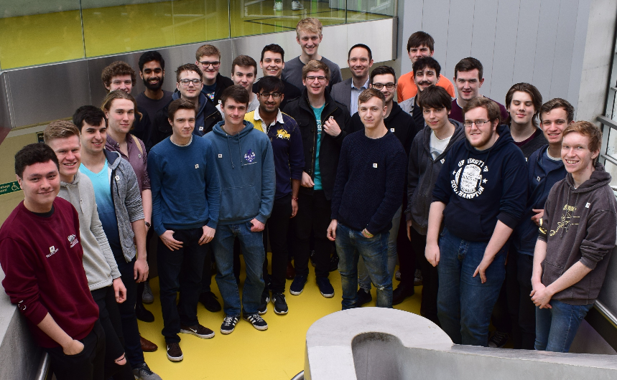
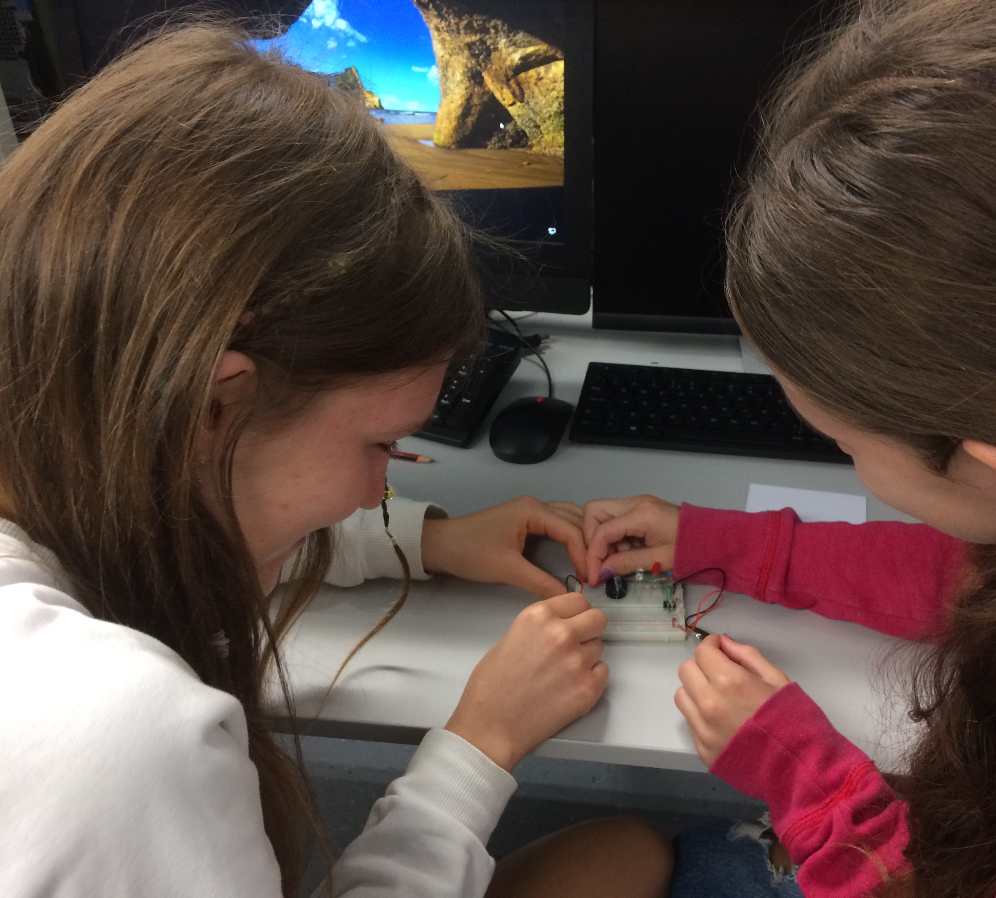

What is the UKESF?
A charitable foundation with one aim:
“To encourage more young people to study Electronics and to pursue careers in the sector.”

Slide 3



























Our University Partners

Slide 4



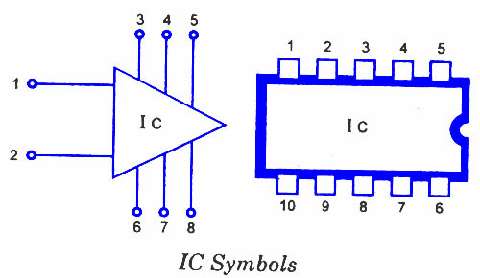


Electronics – some history
1958
1947
1970s
2007

Slide 5


Electronics is everywhere!

Slide 6






Electronics in the near future

Slide 7
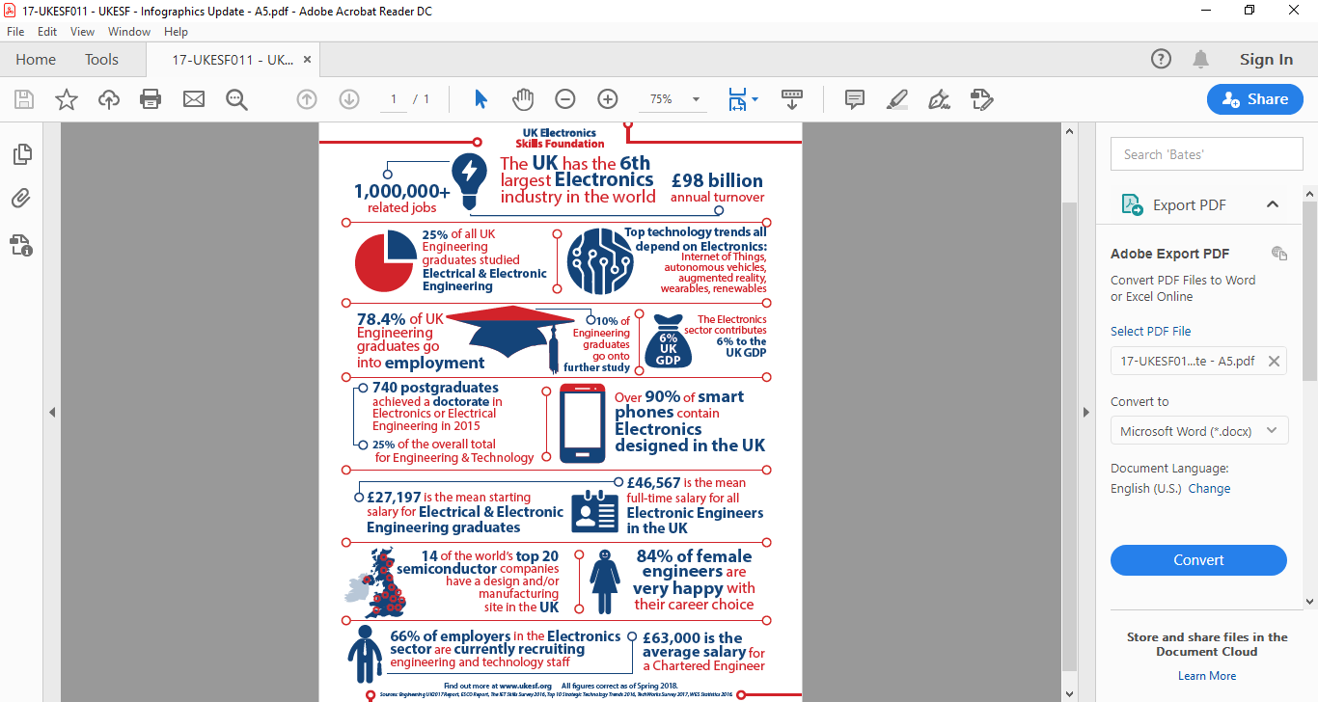
The UK Electronics Industry

Slide 8

About me

Slide 9
Electronics at University
Choosing my university
MEng vs BEng
What it was like starting out
Structure of my course
Topics we studied each year
Labs
Projects
Summer work placements
Plans for after university

Slide 10
Thank you and good luck!

