Slide 1
Insert your name here
Name of your University, Name of your Sponsoring Company

Slide 2
About Me
Insert Pic
Name
Job title
Notes:
Explain what you do. Choose language and words that can be understood by your audience, for example, if you participate in ‘Outreach’, instead say “I share my passion for Electronics with young people”

Slide 3
What is Electronics Engineering?
“Electromagnetism has enabled us to develop phones, radios, televisions, the internet and innumerable other devices.
Condensed matter physics has allowed us to develop microchips that are indescribably small, which has allowed us to shrink our computers from room-sized to pocket-sized.
Electronics engineers have developed medical tools, diagnosis probes and biological instruments that have helped to save countless lives, cure countless diseases and build up a wider understanding of the natural world.
Electronics is not just about a mobile phone or a laptop or a television – it is the screen through which we interact with the world.”
Gareth, Undergraduate Electronics Student

Slide 4
Why Electronics Engineering?
“Imagine creating the next generation of smart devices that can change the world. Electronics offers endless opportunities to innovate and make a real impact. Your innovations could revolutionize how we live, work, and connect.”
Amrik
“Working in Electronics will put you at the forefront of exciting technology and innovation. It gives the chance to actually solve problems in society through tech.”
Matt
“For me Electronics is a very creative discipline. It allows me to use maths and physics to solve real-world hands-on problems, and I find that extremely rewarding.”
Lucy
Notes:
Explain why you are inspired by Electronics Engineering

Slide 5
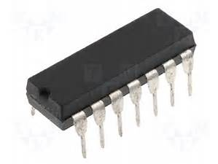
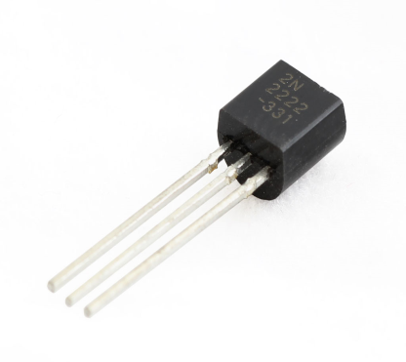
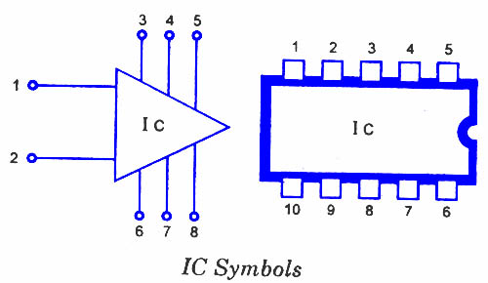
Electronics – some history
1958
1947
2007
1970s

Slide 6
Electronics Industry in the UK

Slide 7
Electronics in Numbers

Slide 8
My journey into Electronics and Engineering
Use this space talk about:
Choosing my university
MEng vs BEng
What it was like starting out
Structure of my course
Topics we studied each year
Labs
Projects
UKESF Scholarship
Summer work placements
Plans for after university

Slide 9
My Project
Use this space to discuss an interesting project that you’ve worked on whilst at University or on placement

Slide 10
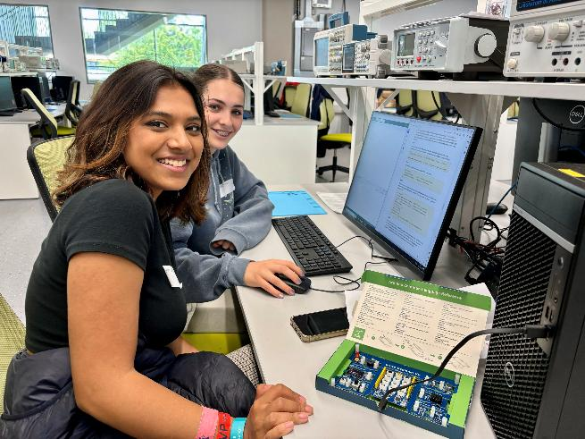
The UKESF
The UKESF works to ensure that more young people can learn about Electronics, in an engaging way, and be aware of the opportunities available.
If you’re interested to find out more about Electronics and access free resources that can help you to develop your interest visit
ukesf.org/get-involved

Slide 11
UKESF Partners
The UKESF partners with universities and employers to support young people to develop their interest and gain experience in Electronics.

Slide 12
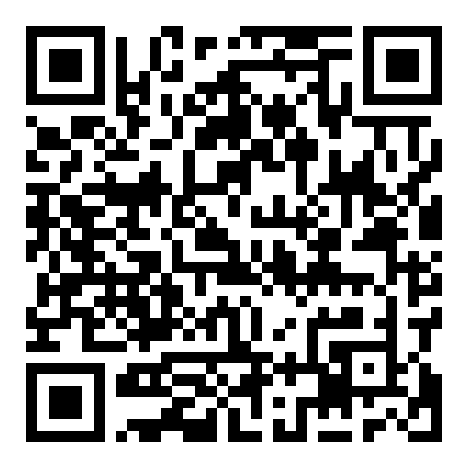
Sign up to our newsletter

