Slide 1
Primary Electronics
Sophie Batin, UKESF
Notes:
Check slide deck is working
Kit boxes and attribute cards ready on tables
Good afternoon year 5/6! I’m X and this is my colleague, Y.
You will personalise this intro:
We work for an organisation called the UK Electronics Skills Foundation or UKESF.
At UKESF, we want to help children understand how Electronics is a part of our everyday lives and what a career working in Electronics might look like for all of you.
So today, we’re going to do some electronics together, using the kits we’ve brought with us. You will have lots of time to explore the kits in a moment but leave them in the boxes for now. Before we get started, I want to make sure that you know that today is about trying something new and you might get stuck or have a question. That’s great – that’s how engineers work in real life. If you do get stuck or want to ask us a question, put up your hand and an adult will come to help you.

Slide 2

What is Electronics?
"Electronics is about using technology creativity, to develop innovative products to help solve problems, and make people's lives better"
Notes:
What is Electronics?
Ask the pupils if they have any ideas.
Use pair and share – ask the question and give pupils 1 minute to talk to their partner and come up with ideas before letting them put their hands up to answer
Electronics is an area of science that focusses on circuits and how electrons move but most importantly, it’s about using tech creatively to… (slide text)

Slide 3

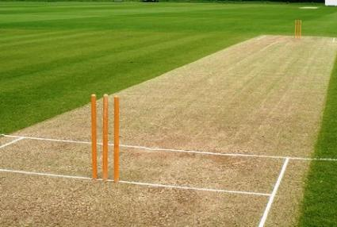
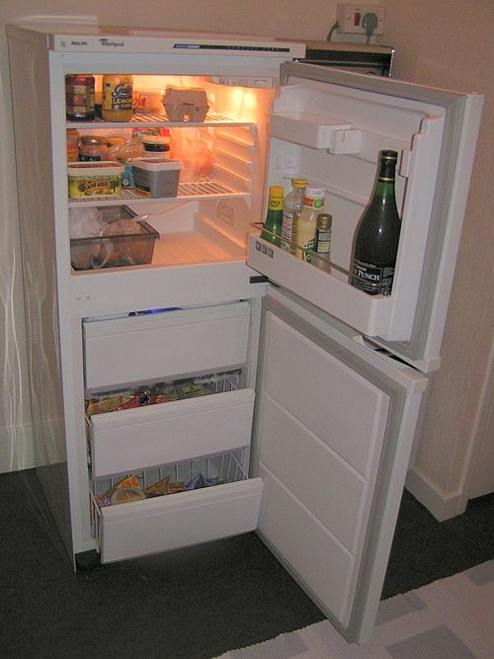



Which of these uses electronics?
Notes:
Which of these uses' electronics?
Ask pupils this. 1 min pair and share.
Answer is that they all have electronics in. Pick one or two (use examples that the children didn’t already pick, if possible) to explain more fully
Clockwise from top left
Frozen the musical – theatre full of electronics for all the lighting, video LED wall, sound, special effects, costumes etc
Cricket – Hawk Eye to accurately track the trajectory of the ball and assist in making decisions such as leg before wicket decisions as well as helping to coach and train the players.
Fridge – monitoring temperature, humidity etc. Smart fridges have Internet connectivity or cameras to monitor contents.
Electric Toothbrush – pressure sensor, timer, smarter ones can link using Bluetooth to track brushing habits
Mobile phone – cpu, monitoring of battery, enables display, network connectivity etc
Football – Smart football, inside are sensors that record and send all data about how the ball is kicked, trajectories etc to improve players game.

Slide 4
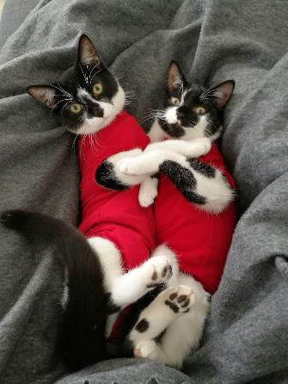
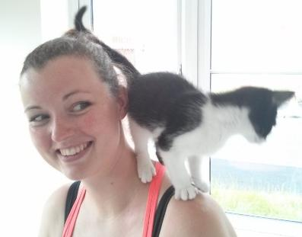
About Me – Sophie Batin
Head of Education, UKESF
How I would describe myself​
Imaginative​
Curious​
Collaborative
I have two children and two cats!
Notes:
You will personalise this slide. This is what Sophie would say in the classroom:
I’m the Head of Education at UKESF and my job is to help young people like you to do Electronics! I love my job because I get to use lots of things I’m good at. I am curious, so I am really interested in finding out about new things like all the ways Electronics impact our lives. I get to use my imagination to come up with lots of interesting ideas and then work collaboratively with my team to decide the best activities to do with young people.
If you want to insert information about your organisation, you could add a single slide after this one

Slide 5
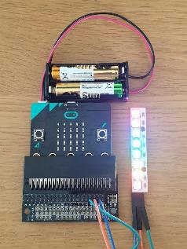
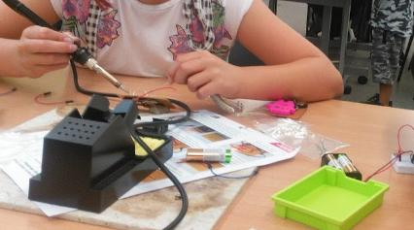

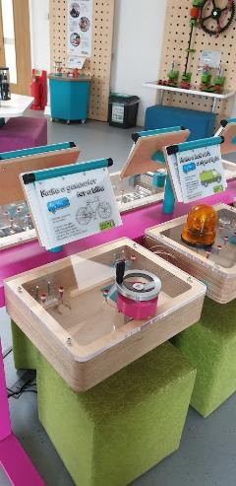

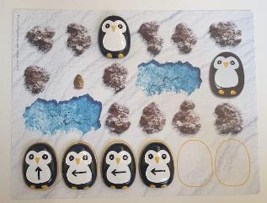
A Project I’ve Worked on:
Communicating About Electronics
Being open-minded
Being organised
Notes:
You will personalise this slide. This is what Sophie would say in the classroom:
I use lots of different ways to talk to different people about Electronics. The little penguins were an activity I did with pre-schoolers, to start thinking about coding and the picture above it is some teenagers soldering wires onto a breadboard to make robots. During Covid, I designed an activity using the micro:bit computer to shine a rainbow in my window. I even got to help design some exhibits for a science centre. I found it easy to be open-minded and listen to other people’s ideas of how to make these projects even better but I found it tricky to stay organised and make sure I finished one project before starting the next.

Slide 6


Skills we will use today
Recovering quickly from problems
Resilient
Putting in lots of effort
Hard-working
Thinking of new ideas
Imaginative
With thanks for support with the STEM Attributes from
Notes:
NUSTEM worked with lots of people doing STEM jobs to come up with a list of characteristics that help scientists and engineers do their jobs well. We are going to use some of those skills today.
Explain:
Resilient – not giving up - being able to recover from problems and try again
Hard working – putting effort in to do your best
Imaginative – thinking of new ideas to try

Slide 7
What are you good at? What might be tricky?
Recovering quickly from problems
Resilient
Putting in lots of effort
Hard-working
Thinking of new ideas
Imaginative
Notes:
Ask children to use the cards to order the skills with the easiest for them at the bottom and the trickiest at the top

Slide 8
Put these attributes in order
Recovering quickly from problems
Resilient
Putting in lots of effort
Hard-working
Thinking of new ideas
Imaginative
Notes:
Example

Slide 9
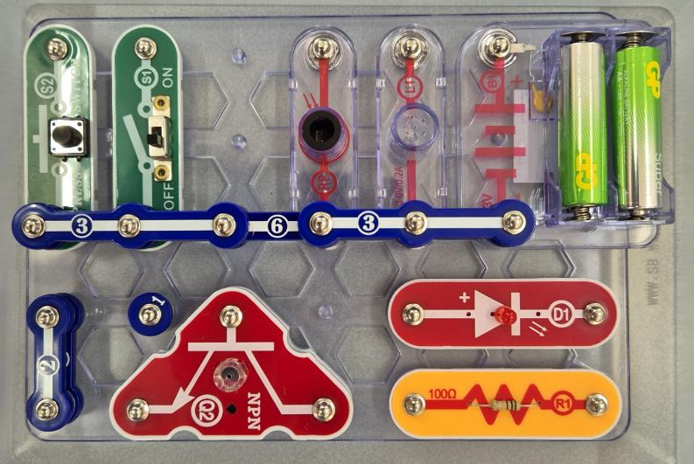
Snap Circuits
You will work in pairs to experiment with circuits using these snap circuit sets
Notes:
The kit we’re using is very safe but there are some rules: don’t put anything in your mouth, keep water bottles away from the kit and keep all the pieces on your table so that no one steps on them by accident.
These kits are special because the pieces snap together on the board so that your circuit can look exactly like the diagram, without any flexible wires getting tangled. Instead of flexible wires, you’re going to use these blue pieces. They are still wires but they don’t bend, so if you want to go around a corner, you’ll need to connect more wires together. You might recognise some components from when you did electricity in science. Some might be new to you.

Slide 10
Circuits Rules to Remember!
Rule #1 –
The battery powers the circuit.
Rule #2 –
There must be a full loop from the + of the battery to the - of the battery (no gaps!)
Battery
3V
B1
Notes:
Review some basics – pupils should have learnt this as part of the year 4 curriculum, so these are a reminder

Slide 11
Circuits Rules to Remember!
Rule #3 –
The LED only works 1 way.
Rule #4 –
The + on the LED must be on the same side as the + as the battery (they do not need to be touching directly!)
LED
D1
LED
Only works 1 way
Notes:
Pupils may not have used LEDs before

Slide 12
Experiment 1 –
Circuit Loops and Resistance
Battery
Wire
Resistor
LED
3V
B1
R1
D1
3
100
Ω
LED
RESISTOR
Only works 1 way
Notes:
Go through the parts, holding up each component as you tell them about it
Battery – powers the circuit
Wire - allows electricity to travel along them
Resistor - If we have too much electricity which could damage a component, it turns it into heat to make it safe
LED –a light which turns on when it gets enough electricity
You will know your circuit is working because the LED will light up

Slide 13
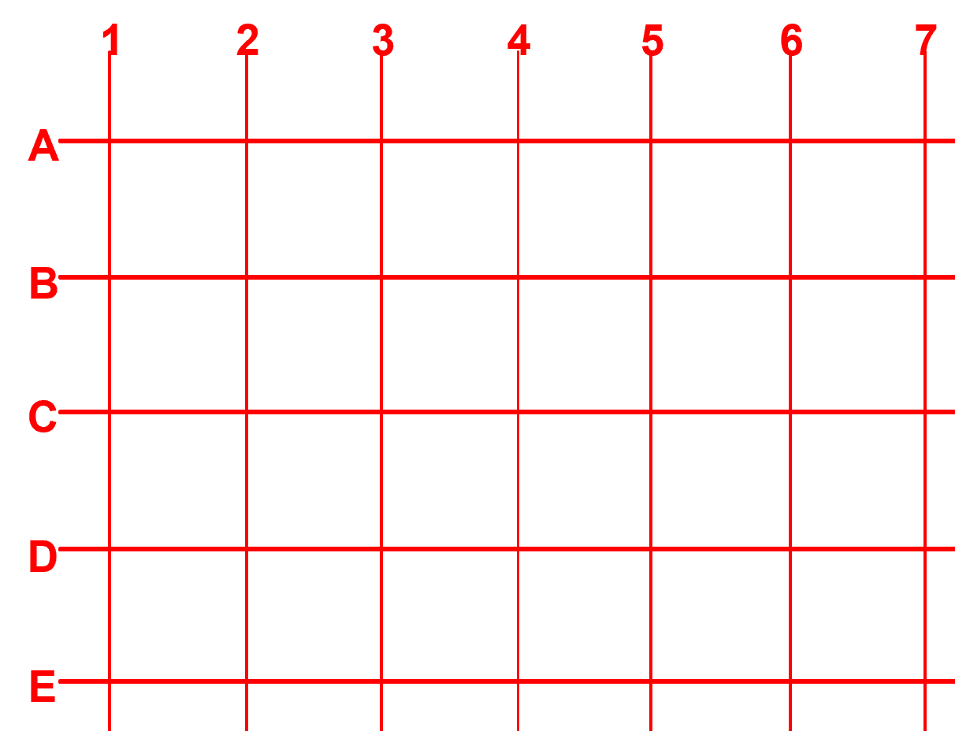
Experiment 1 –
Circuit Loops and Resistance
Step 1 –
Put battery on the very edge of the board so you are snapping onto column 7, rows C-E
Put the 3 wire onto column 5, rows C-E
3V
3
B1
Notes:
Show the base and explain:
The base helps you to create circuits that look exactly like the diagram on the board. This means it’s easier to troubleshoot any problems with your circuit by comparing it to the diagram and spotting any differences
Demonstrate putting on the parts using your own kit

Slide 14
Experiment 1 –
Circuit Loops and Resistance
Step 2 –
Put the resistor on top of the wire and battery along row C
Put the LED on top of the wire and battery along row E.
R1
100
Ω
RESISTOR
3V
3
B1
D1
LED

Slide 15
Experiment 2 – LED and Lamp
Battery
Wires
LED
Lamp
Switch
3V
2
D1
LED
LAMP
S1
3
SLIDE SWITCH
B1
Only works 1 way
Or
6
S2
PRESS SWITCH
Notes:
Explain the new components:
Lamp – a little light bulb
Switch - controls the flow of electricity by either allowing it to pass through when you close the switch (ON) or not letting I through when you open it (OFF)
Pupils are likely to be familiar with lamps and switches. They can choose which type of switch to include

Slide 16
Experiment 2 – LED and Lamp
6
2
3V
D1
LAMP
LED
B1
3
S1
SLIDE SWITCH

Slide 17
Experiment 3 – Tilt Switch
Battery
Wires
LED
Lamp
Tilt switch
3V
2
D1
C
LED
LAMP
S7
3
B1
1
TILT SWITCH
2
6
Notes:
Electronic circuits are different from electrical circuits because they have processing power, which means they behave differently depending on the information they receive. Adding a tilt switch turns your circuit from an electrical circuit into an electronic circuit because the switch allows your circuit to behave differently depending on how you hold it.
Explain:
Tilt switch – This works by rolling a small piece of metal inside it around, with it only allowing electricity to flow when you hold it a certain way.
To test your circuit, you will need to move it and see how the LED changes

Slide 18
Experiment 3 – Tilt Switch
6
2
D1
LED
LAMP
3V
C
B1
S7
1
TILT SWITCH
2
3

Slide 19
Experiment 4 – Light Sensor
Battery
Wires
LED
Light Sensor
3V
D1
RP
2
LED
PHOTO
RESISTOR
3
B1
Resistor
Transistor
R1
6
100
Ω
RESISTOR
Switch
NPN
Q2
S1
SLIDE SWITCH
Notes:
Explain:
Light Sensor – changes resistance with the amount of light it receives. If you cover the light sensor so it has no light, then the resistance is really high and no electricity can get through. If it has lots of light, then a lot of electricity can get through and turn on the LED. Demonstrate covering the sensor with your hand
Transistor - A transistor does lots of different jobs. Here, makes sure enough electricity gets to the right place to make the circuit work
Testing: the LED will turn on and off as you use your hand to cover the sensor

Slide 20
Experiment 4 – Light Sensor
6
R1
D1
100
Ω
S1
RESISTOR
LED
SLIDE SWITCH
3
3V
RP
NPN
PHOTO
RESISTOR
Q2
B1
2

Slide 21
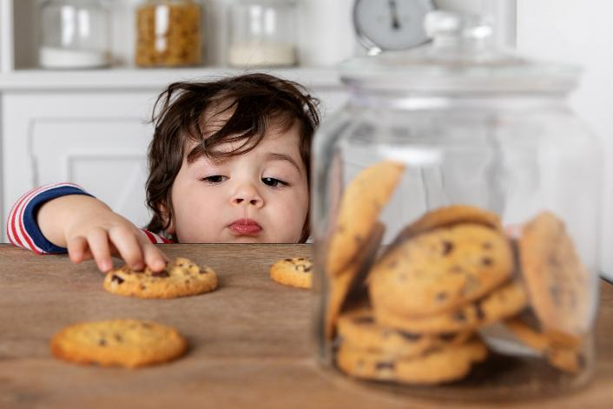
The Challenge!
Your teacher has a jar of special biscuits that we need to keep safe!
Your challenge is to create a system that will warn the teacher if anyone gets close to stealing the biscuits.
Notes:
Introduce the challenge and explain the time they have to complete it (20 mins)
Children can use any of the parts. They do not have to use them all.
Suggest that the light turning off or on is the warning for the teacher that their biscuits are at risk!

Slide 22
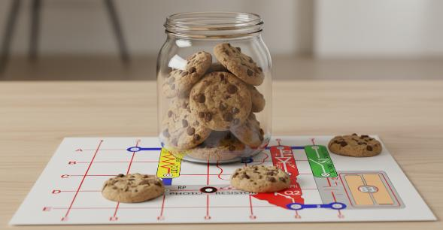
The Challenge!
Think about how the thief may try to steal the biscuits?
  Will they tilt the biscuit box lid as they open it?
  Will they move the biscuits jar?
For example, if the biscuit jar is on top of the snap circuit and the biscuit jar was moved, you could use a light sensor to detect when there is a change in light.
6
100
Ω
R1
D1
S1
RESISTOR
LED
SLIDE SWITCH
3
3V
RP
NPN
B1
PHOTO
RESISTOR
Q2
2
Notes:
Talk through the example, emphasising that this is one solution and there are lots of different ways to complete the challenge
Tell children that once their circuit is complete, they should explain how it works to an adult and ask them to take a photo – make sure teachers/ TAs are doing this!
They may have time to make more than one circuit

Slide 23
100
Ω
R1
6
2
When your circuit is complete, explain how it works to an adult and ask them to take a photo
RESISTOR
3V
3V
3
B1
D1
B1
LAMP
LED
D1
3
S1
LED
SLIDE SWITCH
Experiment 1 – Circuit Loops and Resistance
Experiment 2 – LED and Lamp
6
6
100
Ω
R1
D1
S1
RESISTOR
LED
2
SLIDE SWITCH
D1
3
LED
LAMP
3V
3V
B1
RP
NPN
B1
C
PHOTO
RESISTOR
Q2
S7
1
TILT SWITCH
2
2
3
Experiment 3 – Tilt Switch
Experiment 4 – Light Sensor
Notes:
Keep up as children are working
Can hand out print outs of these sheets if desired

Slide 24
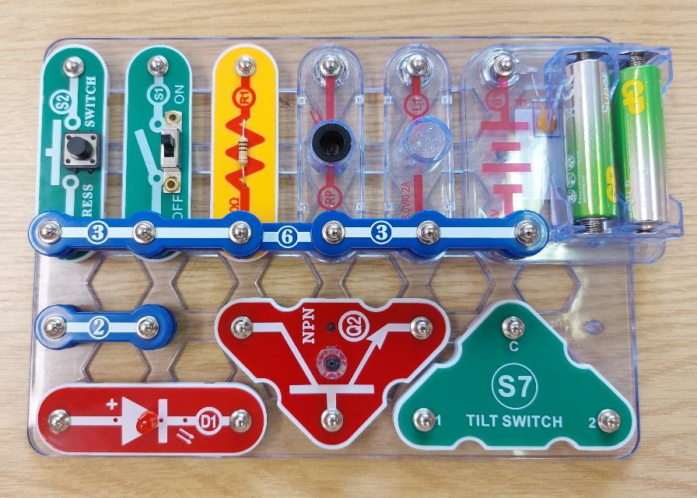
Tidy up!
Please arrange all the parts on the base to look like the picture.
Look carefully – some pieces are stacked up together!
Notes:
Collect in kits and hand out final worksheets

Slide 25
We used all these skills today, in different parts of the workshop
Recovering quickly from problems
Resilient
Putting in lots of effort
Hard-working
Thinking of new ideas
Imaginative

Slide 26
Recovering quickly from problems
Resilient
Learning how to use snap circuits and remembering the circuit rules
Following the instructions to make your circuits
Putting in lots of effort
Hard-working
Thinking of new ideas
Imaginative
Notes:
With your partner, match up the skills you used to the different parts of the workshop. The attributes will match to more than one part!

Slide 27
Thank You!
Notes:
Hand out any extras that you have brought with you and pack away any remaining kit

