Slide 1
Primary Electronics: Build a Bot
Session 5 - Communicate

Slide 2

Communication
Today you will be creating something to let other people know all about your Bot!
We want to know:-
  Which skills your team found easy
  Which skills your team found tricky
  What you enjoyed about making your Bot
  What you would do differently next time
Notes:
You can link this to anything that you are currently working on or use it as an opportunity to be creative!
Example – If you are covering informative writing, you could have your students create a short magazine article about how they built their robots.
Types of media the students could create:
Posters
Cartoons
PowerPoints
Reflective account
Magazine article
Instructions
A play or skit
Labelled photographs
Floor book

Slide 3
Which skills will we use today?
Sharing information and ideas
Communication
Putting in lots of effort
Hard-working
Caring a lot about your work
Passionate

Slide 4
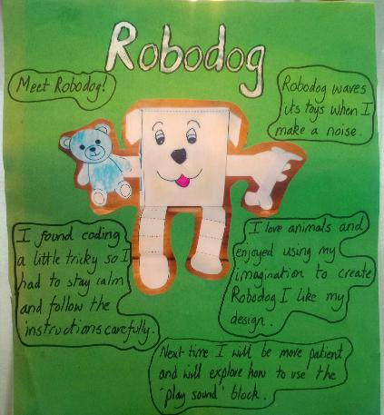

Communication - Poster
What you could include in your poster:
  Your Bot’s name
  A picture of your Bot
  What your Bot can do
  What went well
  What went wrong
Make sure you include:
  Which skills your team found easy
  Which skills your team found tricky
  What you enjoyed about making your Bot
  What you would do differently next time
Notes:
This is an example, please feel free to use any format that works for your class.
Please send any completed work you’re happy to share to us at education@ukesf.org or share on socials and tag us. We’re @UKESF on Instagram, UKESF – UK Electronics Skills Foundation on Facebook or Uk Electronics Skills Foundation (UKESF) on LinkedIn.

Slide 5















Here are all the skills to help you remember which were easy and which were tricky
Working with others
Collaborative
Sticking with an activity.
Committed
Sharing information and ideas.
Communication
Making new things.
Creative
Learning about new things.
Curious
Putting in lots of effort.
Hard-working
Thinking of new and interesting ideas.
Imaginative
Solving problems in sensible ways.
Logical
Noticing small details.
Observant
Listening and respecting others’ views.
Open-minded
Planning how to finish things.
Organised
Caring a lot about your work.
Passionate
Staying calm when facing problems.
Patient
Recovering quickly from problems.
Resilient
Doing things without being told to.
Self-motivated

Slide 6
Primary Electronics: Build a Bot
Extension Activities

Slide 7
Extensions to your Bot
In this section we will give you suggestions about how you can improve your Bot.
Using the Bot as it is you could change the code. Here are some suggestions:
Can you change how long the Bot waves its arms for?
Can you use the “play sound” block so the Bot can join in the noise?
Experiment with the other blocks to make the Bot do other things.

Slide 8
Make your Bot a TickleBot!
You can easily convert your Bot into a TickleBot!
The Bot will react when you touch or tickle it.
The extra items you will need are:
  Tin foil
  2 x crocodile cable with a clip at both ends
  Glue/tape

Slide 9
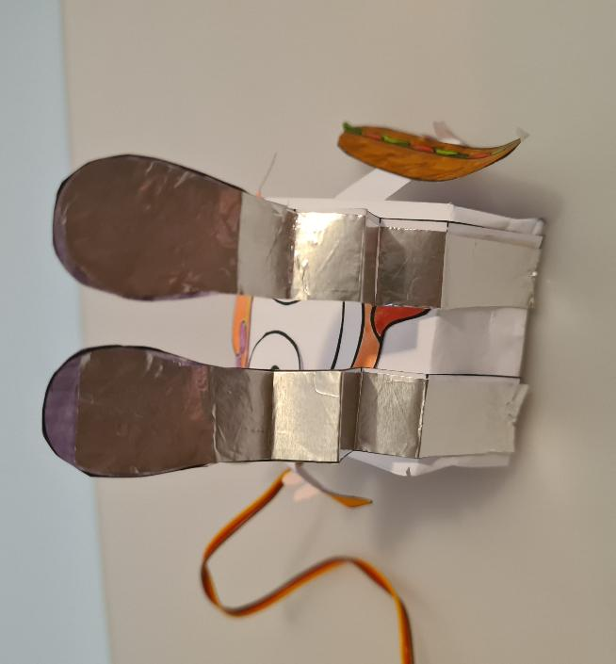
Adding foil
Cut two pieces of tin foil the same size as the legs. You can use the template again to help.
Tape or glue the foil to the underside of each of the legs.

Slide 10
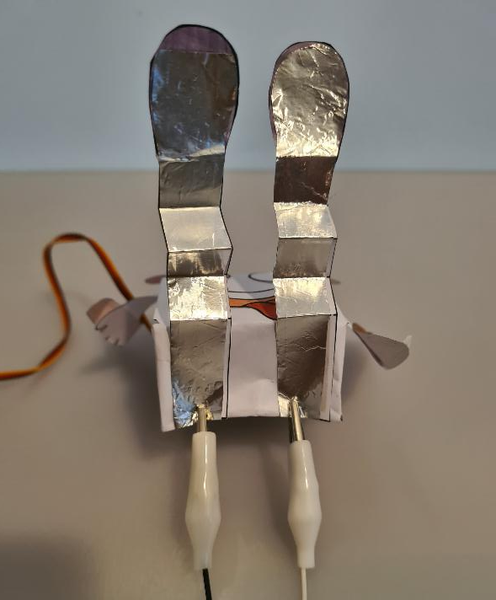
Clips
Using the 2 crocodile cables, attach one end of each cable to the body end of each leg.
Make sure the clips are touching the tin foil.

Slide 11
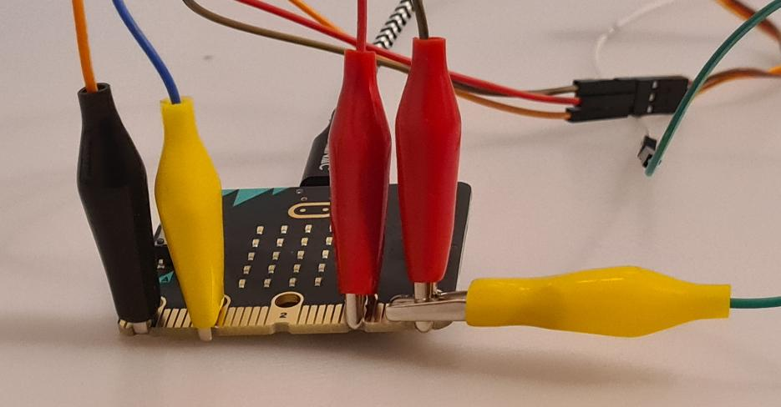
Attaching to the micro:bit
Connect one of the cables to the ground – this already has a clip, so attach to the current clip.
Connect the other one to the pin 1

Slide 12
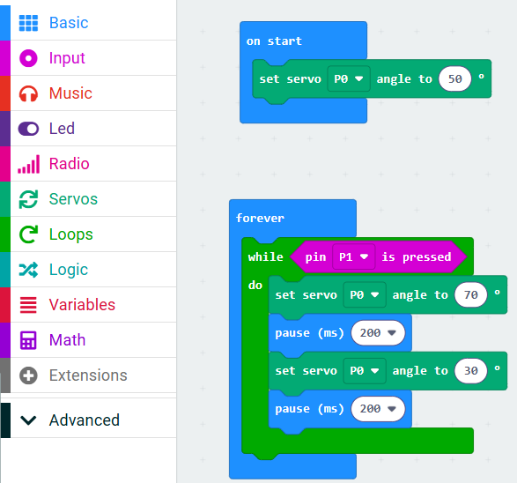
Coding the micro:bit
Return to:
makecode.microbit.org
You can edit your previous code to be the same as the code here.
  Keep the servo code by dragging it out of the repeat loop
  Delete the parts you don’t need by dragging them to the menu.
  Add in the forever loop from the Basic menu.
  Add in the while loop from the Loops menu
  Add in the pin block from the Input menu

Slide 13
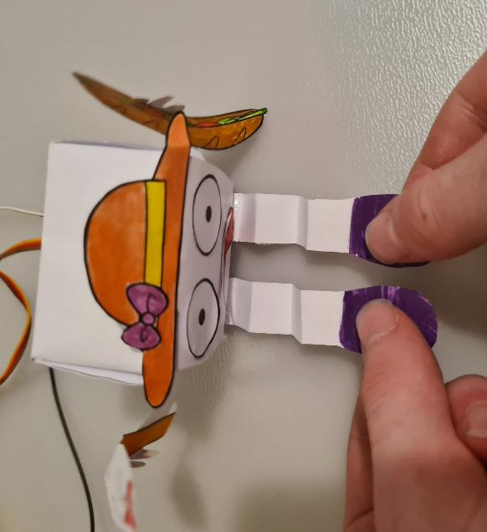
Test your TickleBot
Connect the micro:bit’s micro USB cable into the computer you re writing your code on.
Click on the Download button.
Folow the on-screen instructions to pair your micro:bit with the computer.
This should end with the code being downloaded onto your micro:bit.
Then tickle the back of both of your TickleBot’s legs and it will cheer!

Slide 14
Further extension
A 2-servo version of the TickleBot
https://www.jasmineflorentine.com/ticklebot

