Slide 1
Primary Electronics: Build a Bot
Session 4 - Test
Notes:
The test section is optional and can be used as a catch up session if some teams have built their bot and some need more time.
To do these tests, it is recommended groups do it in a quieter place than the main classroom if possible.

Slide 2
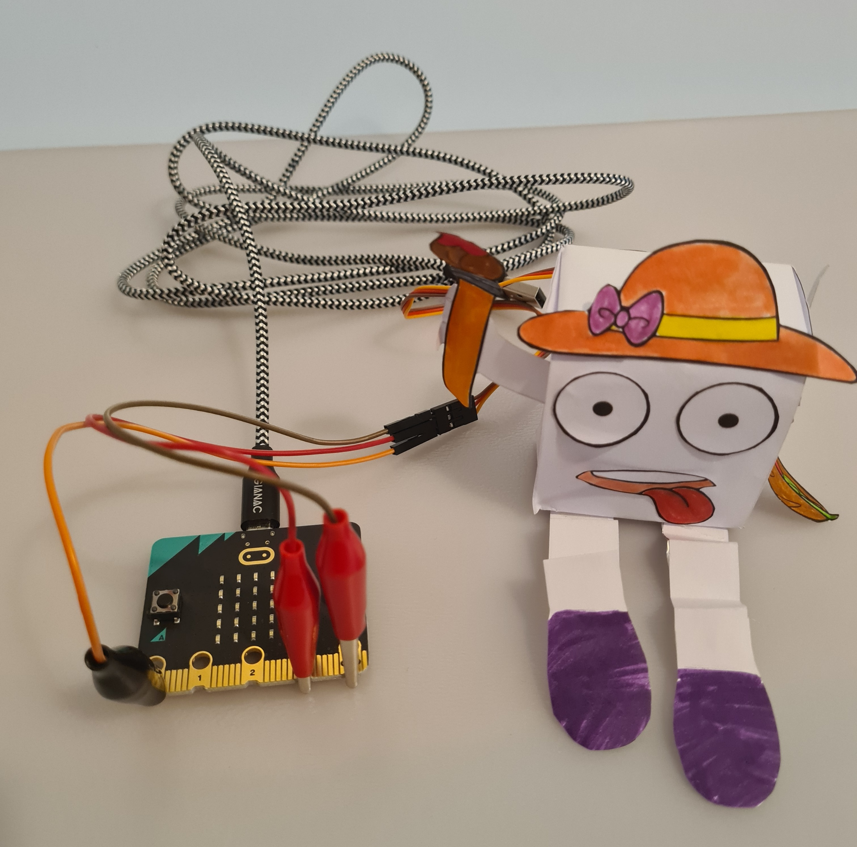
Testing
This session is about testing your Bot.
Remember the original purpose of the Bot was:
“The Bot will guard your classroom and wave whenever someone makes a noise.”
So we need to test how well your Bot does this.

Slide 3
Which skills will we use today?
Sticking with an activity
Committed
Doing things without being told to
Self motivated
Planning how to finish things
Organised

Slide 4
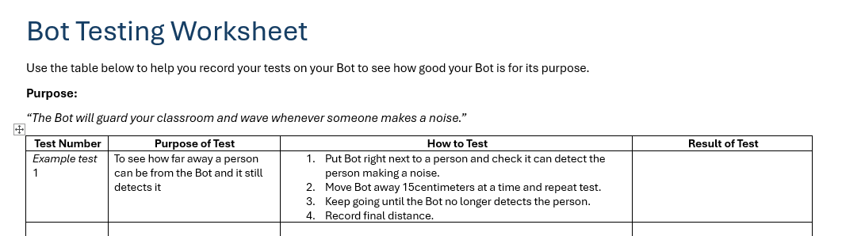
Testing Table
You will be using a testing table to plan and then record the results of your testing.
Example tests you can use are:
To see how far away a person can be from the Bot and it still detects it
To see if the Bot works if it is hidden under a book

