Slide 1
Primary Electronics: Build a Bot
Session 3 - Make

Slide 2
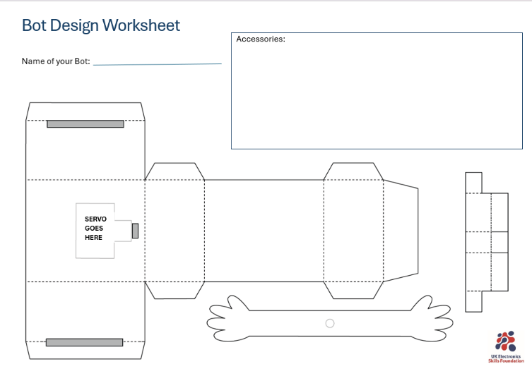



Making
This session you will be making your Bot.
What you will need:
Your Bot worksheet from session 1
Scissors
Tape/Glue

Slide 3
Which skills will we use today?
Working with others
Collaborative
Recovering quickly from problems
Resilient
Staying calm when facing problems
Patient

Slide 4
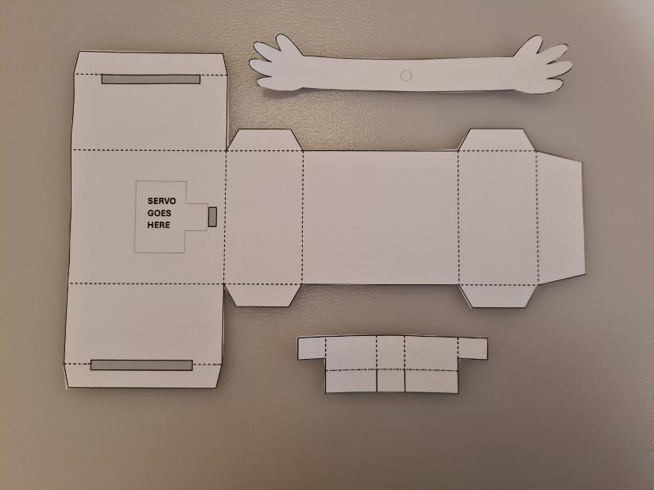
Cutting
Start by cutting all your pieces out from your Bot Design worksheet.
On the servo holder (bottom smallest piece in photo) you will need to make small cuts on the 2 solid lines as well.

Slide 5
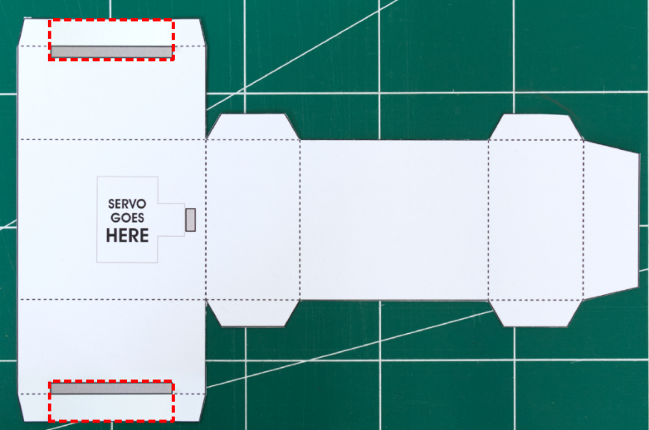
Cutting
There are some grey sections to cut out. If these are too hard to cut, here are some possible other ways to cut them.
Instead you can cut along the red lines. This will result in the bot being a bit flimsier. But it will be enough to tape together.

Slide 6
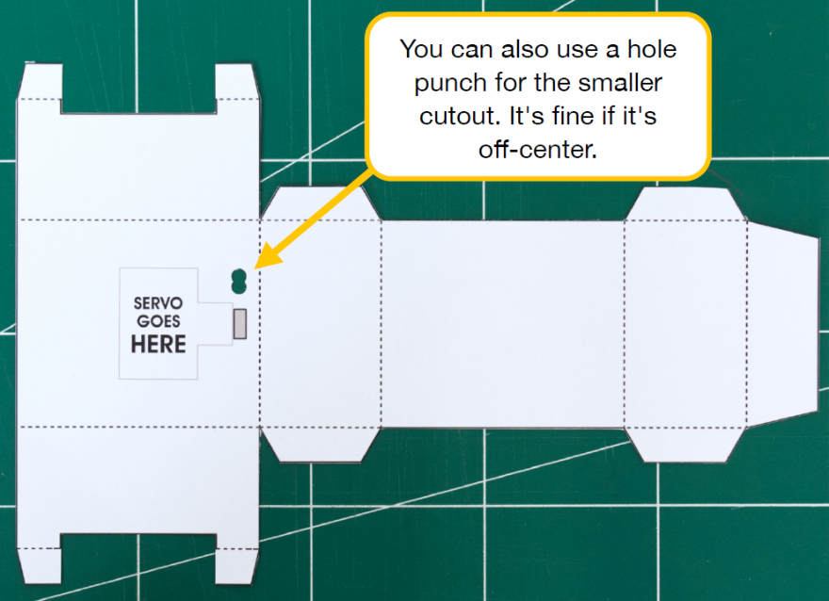
Cutting
There are some grey sections to cut out. If these are too hard to cut, here are some possible other ways to cut them.
Instead of the small grey rectangle, you can use a holepunch. Punch two holes next to each other.

Slide 7
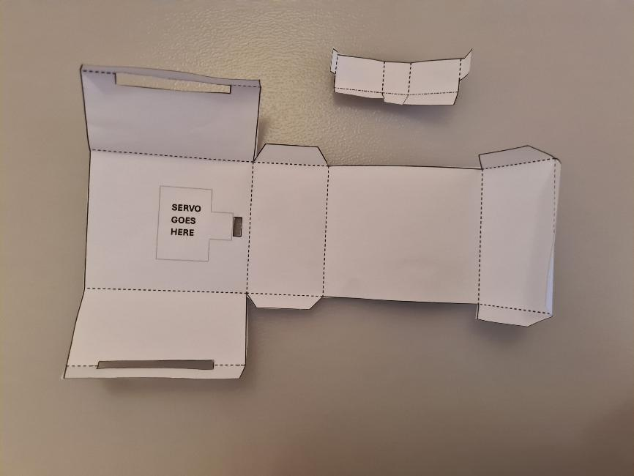
Pre crease
Pre crease all of the dotted lines to make it easier to put together later.

Slide 8
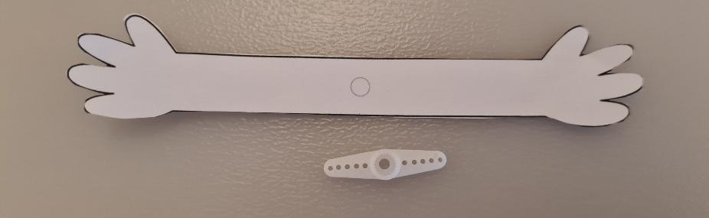
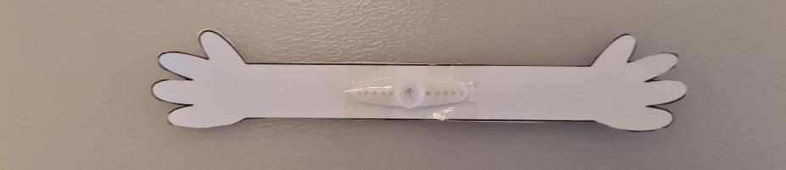
Arms
Tape a servo horn to the middle of the arms where the small circle is.

Slide 9
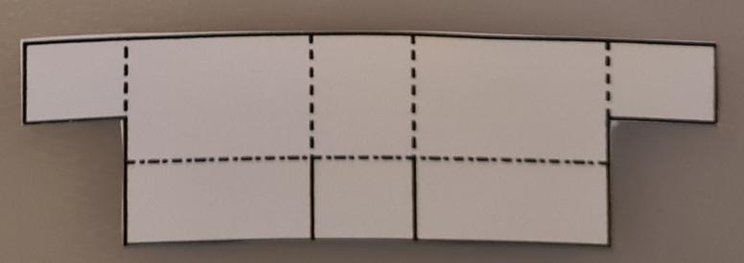
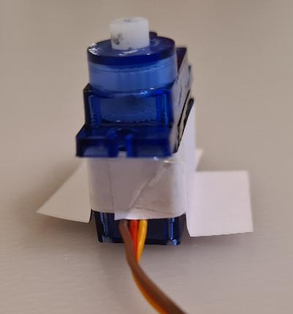
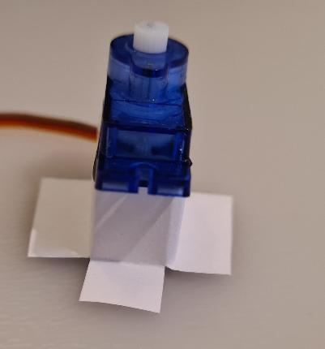
Servo
Tape the servo holder around the servo. Wrap the paper around then tape over the paper tabs.
Make sure the tabs on the bottom are folded out.

Slide 10
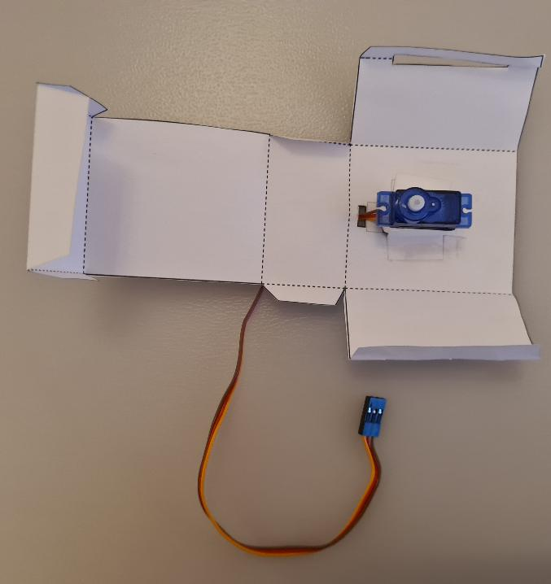
Attaching servo
Pass the servo header through the small hole. Then tape the servo in place as shown.
Only need to put tape onto the paper tabs of the servo holder.

Slide 11
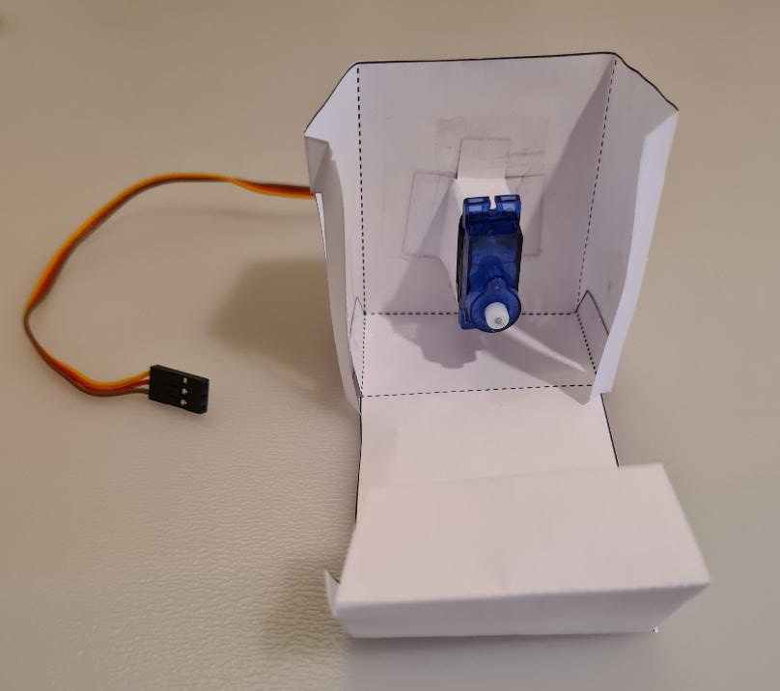
Building the body
Tape the back and bottom of the body together.
Put tape on the two tabs at the bottom of the box.

Slide 12
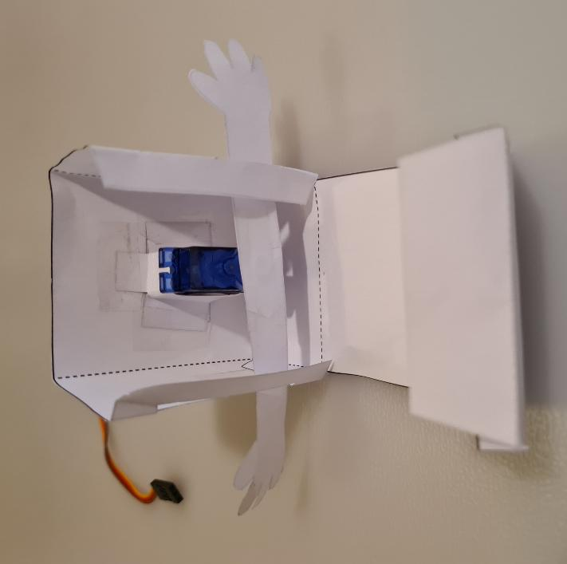
Arms
Slide the arms through the cutouts with the servo horn facing inwards towards the servo.
Push the arms onto the servo in a horizontal position.

Slide 13
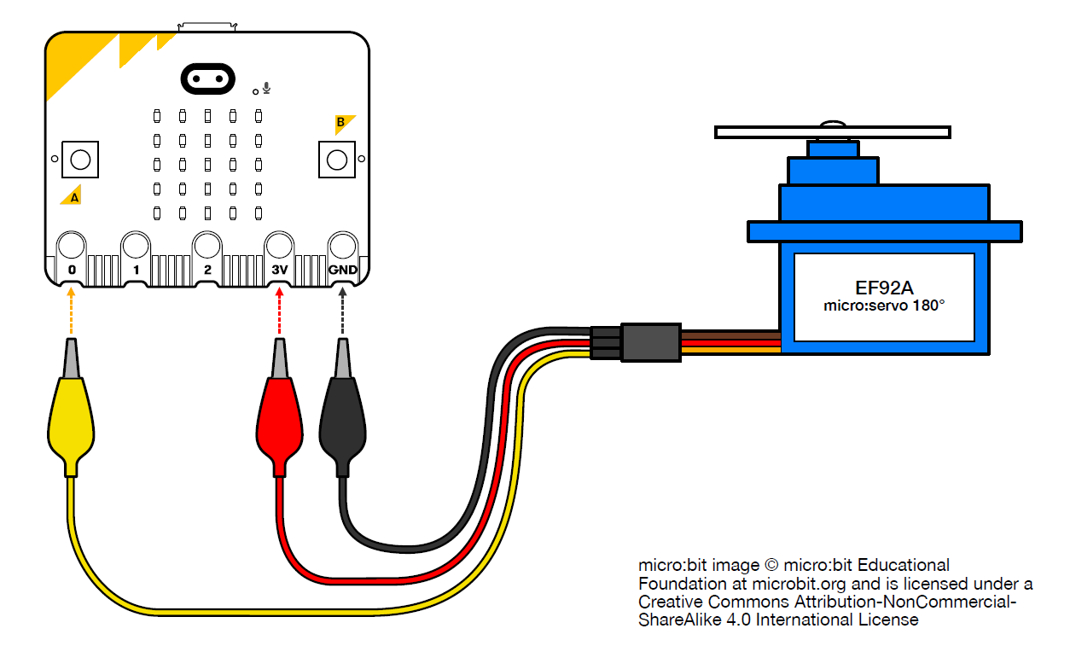
Testing the Arms
Re attach the micro:bit to the servo. Here is a reminder of how the wires are attached.
Crocodile clip connected to the YELLOW servo wire → micro:bit pin 0
Crocodile clip connected to the RED servo wire → micro:bit pin 3V
Crocodile clip connected to the BROWN servo wire → micro:bit pin GND

Slide 14
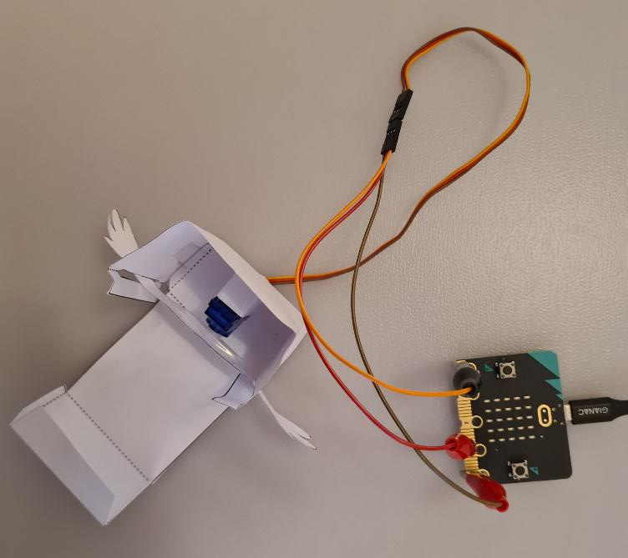
Testing the Arms
Plug the micro:bit micro USB into the micro:bit and the other end into a computer.
Make a loud noise and see how the arms move.
If the arms are at the wrong angle and are not fitting in the slots, remove the arms completely, then re attach horizontally again.
Keep testing till the arms are moving happily in the slots.

Slide 15
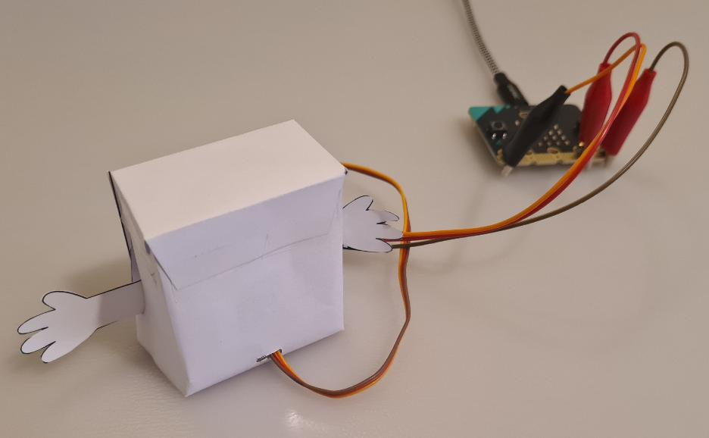
Front of body
Tape up the front of the body by folding the front over and taping the 3 tabs down.

Slide 16



Decorate
Now you can decorate your Bot however you like!
Add the accessories you designed before.

Slide 17
Which skills did we use today?
Working with others
Collaborative
Recovering quickly from problems
Resilient
Staying calm when facing problems
Patient

