Slide 1
Primary Electronics: Build a Bot
Session 2 - Code

Slide 2
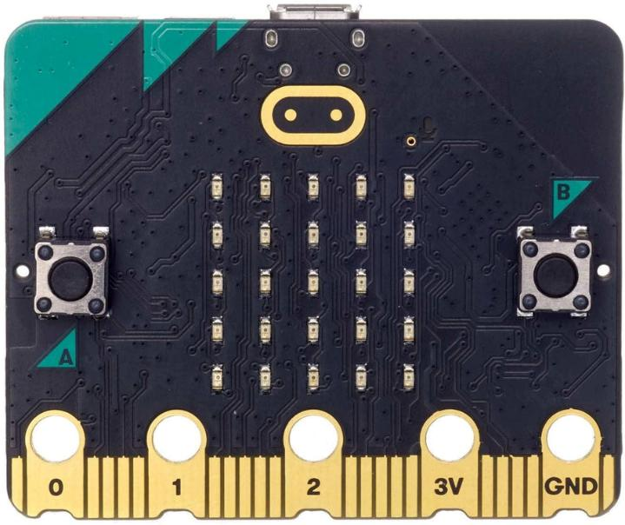
Coding Session
In this session you will be writing the code for your Bot on a Micro:bit

Slide 3
Which skills will we use today?
Solving problems in sensible ways
Logical
Putting in lots of effort
Observant
Learning about new things
Curious

Slide 4
Micro:bits
In this session you will be connecting your micro:bit to the servo and writing the code.
What is a micro:bit?
The micro:bit is a little computer that you can code to react to the world around it using its amazing sensors.

Slide 5
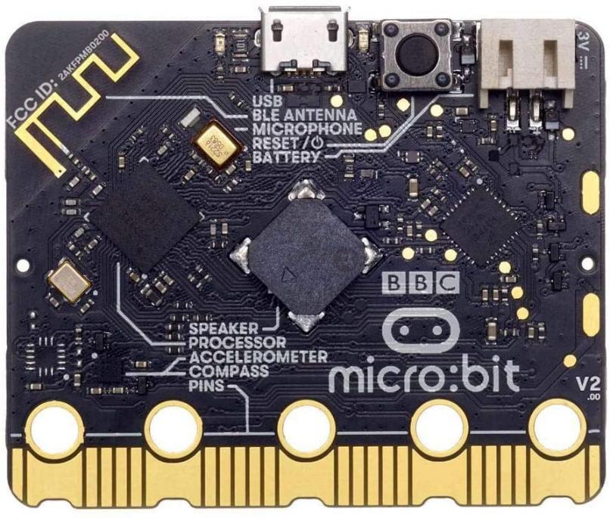
Micro:bits
The micro:bit has sensors as well, but they are smaller and harder to see!
For the Bot we are going to use the microphone to sense any loud noises.
Can you see it on the micro:bit?

Slide 6
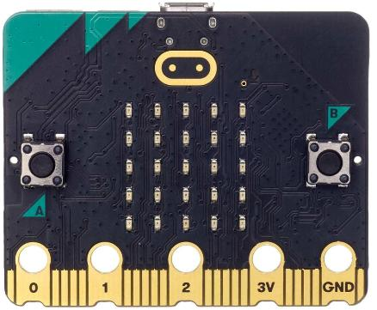
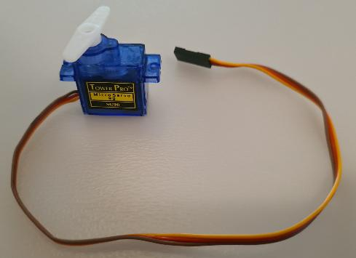
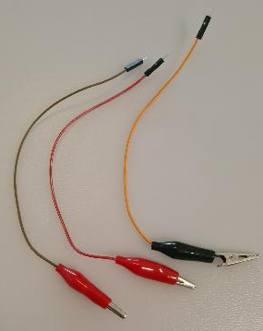
Connecting the parts
Parts you need today:
Micro:bit | Servo | x3 Crocodile to jumper pin cables

Slide 7
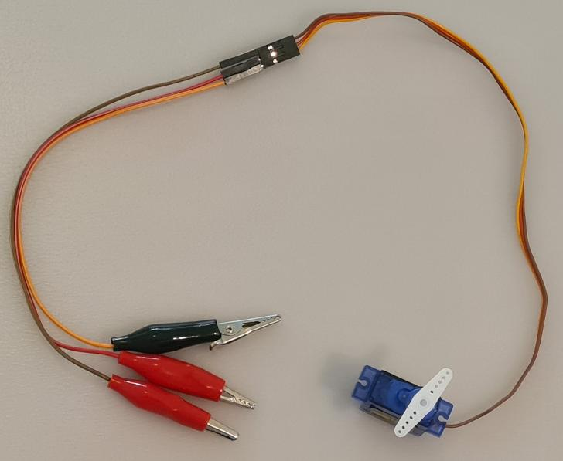
Connecting the parts
Connect the 3 crocodile to jumper pin cables to the servo header

Slide 8
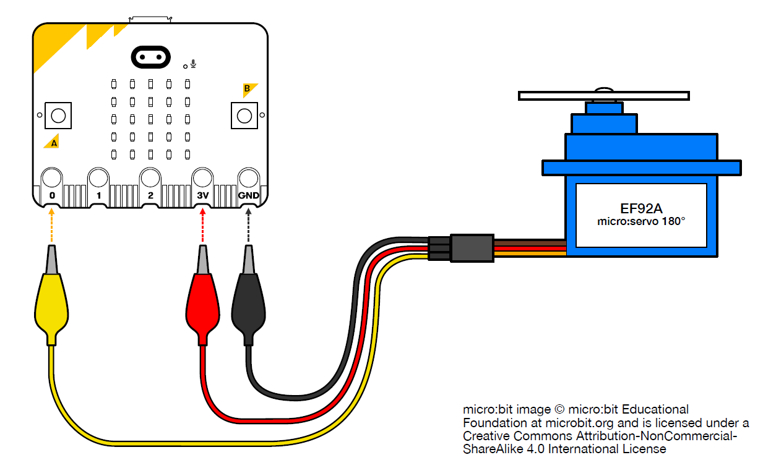
Connecting the parts
Connect the crocodile clips to the micro:bit as follows:
Crocodile clip connected to the YELLOW servo wire → micro:bit pin 0
Crocodile clip connected to the
RED servo wire → micro:bit pin 3V
Crocodile clip connected to the
BROWN servo wire → micro:bit pin GND
NOTE: the colours of the wires attached to the crocodile clip may NOT match.
It is important to just ensure the right servo colour wire goes to the right pin.

Slide 9
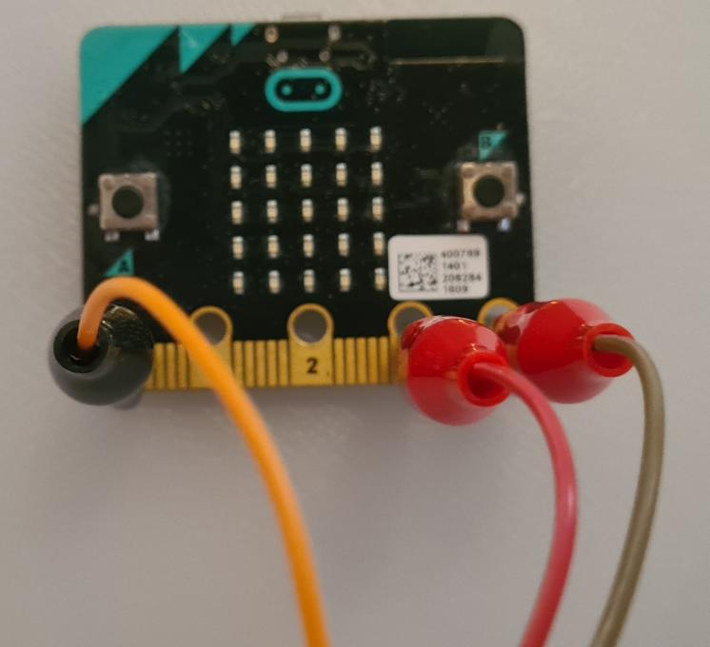
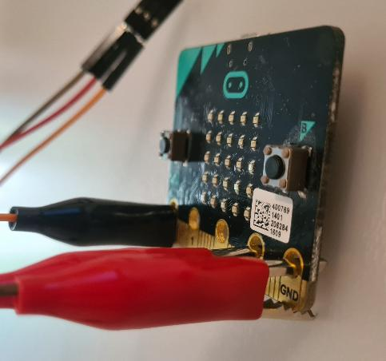
Connecting the parts
Note that the clips are attached perpendicularly to the micro:bit for a more secure grip.

Slide 10
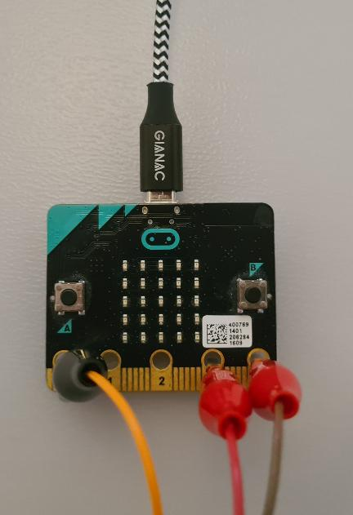
Connecting the parts
Finally connect the micro USB cable to the micro:bit.
NOTE:
Be gentle with cable. It only goes in one way up!
It will stick out a little bit like in the photo

Slide 11
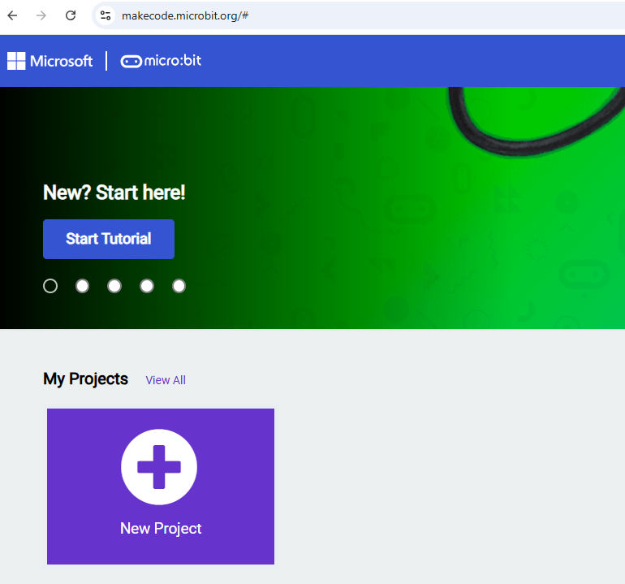
Write the code
You will be writing the code on the micro:bit website.
Go to:
https://makecode.microbit.org
Then click on “New Project”.
1.
2.

Slide 12
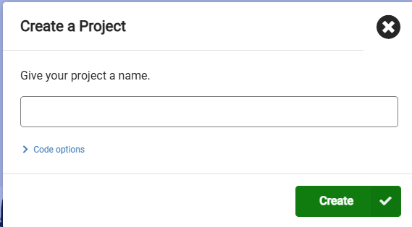
Write the code
A window will pop up asking you to name the project.
Type in your Bot’s name!
Then click on “Create”.
1.
2.

Slide 13



Writing the code
You will need to write code that will change the angle of the servo when the micro:bit senses a loud noise. Changing the angle will mean the arms attached to it will move up and down like a wave.
We will do this in a few steps:
1. Set up micro:bit code editor so we can write code for a servo
2. Write the “start” block of code to:
Set the servo to a particular angle when it turns on (50º)
Set the level of “loudness” that we want the Bot to react to by waving
3. Write the “loud sound detected” block of code to:
Set the servo to 70º and pause
Set the servo to 30º and pause
Repeat 6 times
Set the servo back to 50º

Slide 14
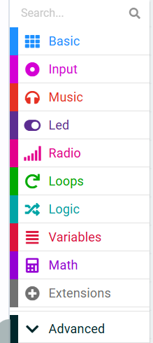
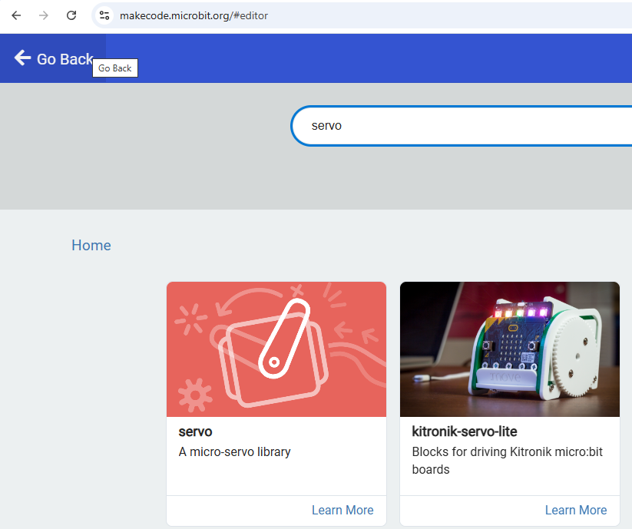
1. Step up the micro:bit editor
You will need to add an extension to use the servo with the micro:bit.
Click on “Extensions” in the menu
Type in “servo” in the search bar then press Enter.
Click on the servo icon that will appear
2.
3.
1.

Slide 15
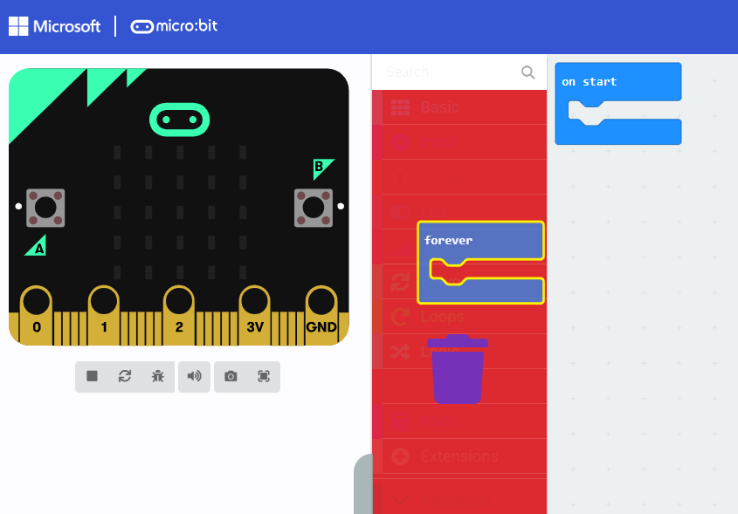
1. Step up the micro:bit editor
Remove the “forever” block by dragging it over the menu and letting go when you see a “bin” icon.

Slide 16
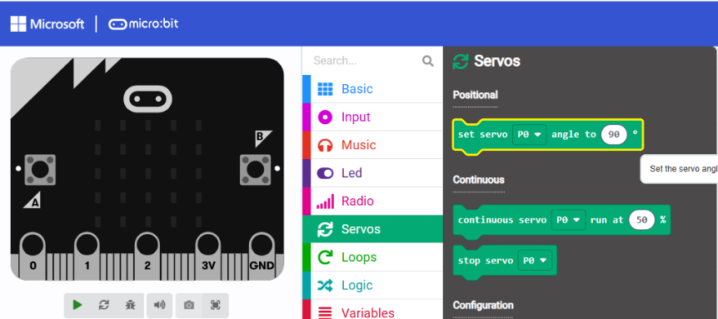
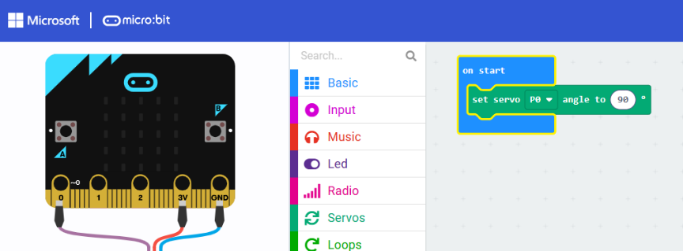
2. Write the “start” block of code
1.
Click on “Servos” on the menu and select “Set the servo angle” line.
Drag this to the middle of the “start” block of code.
2.

Slide 17
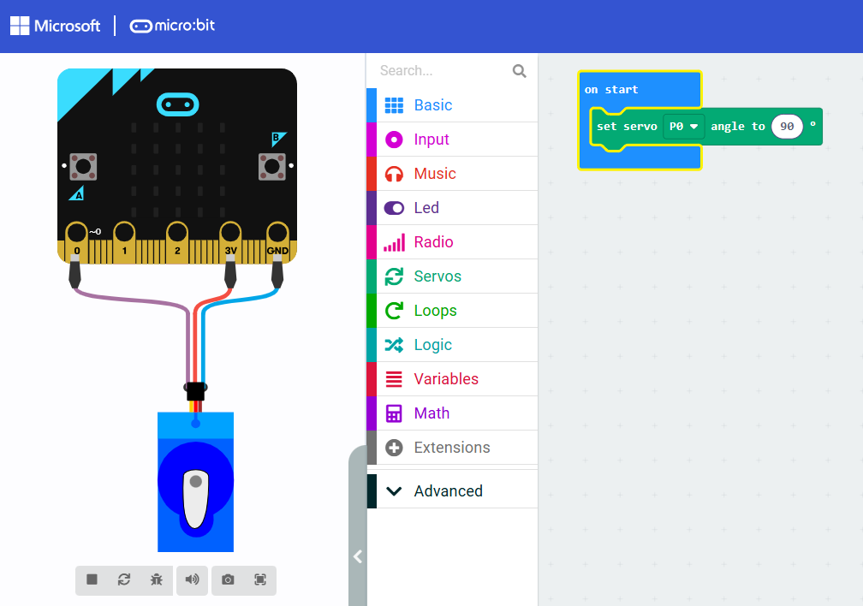
2. Write the “start” block of code
Click ‘run’ to see the servo attached to the micro:bit appear in the emulator, just like the one we have connected

Slide 18
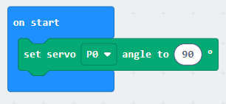
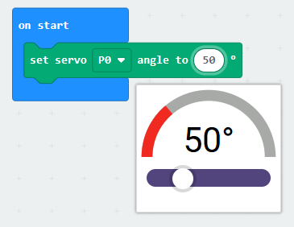
2. Write the “start” block of code
This block of code tells the servo to turn to a particular angle when the micro:bit is first started.
At the moment it says 90. But you will need to change it to say 50. You can do this by clicking on the number “90” and replacing it with “50”.
You may find later that you want to change this if the angle is not right when your Bot is waving.
1.
2.

Slide 19
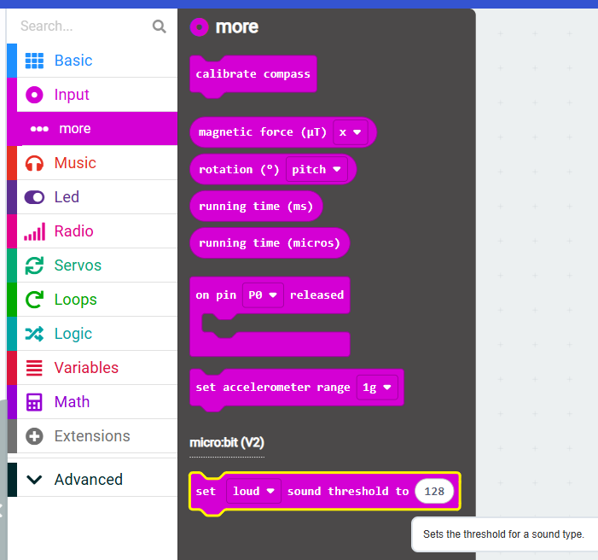
2. Write the “start” block of code
Click on “Input” on the menu.
Then click on “… more”.
Then select the last block of code that sets the loud sound threshold.
1.
2.
3.

Slide 20
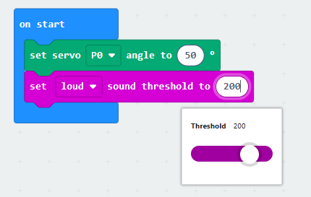
2. Write the “start” block of code
Drag the “on loud sound” block of code into the “start block” of code under the set servo block.
Edit the threshold to 200. You will need to return to this number later to change how sensitive you want your Bot to be.
The start block is now written.
1.
2.

Slide 21
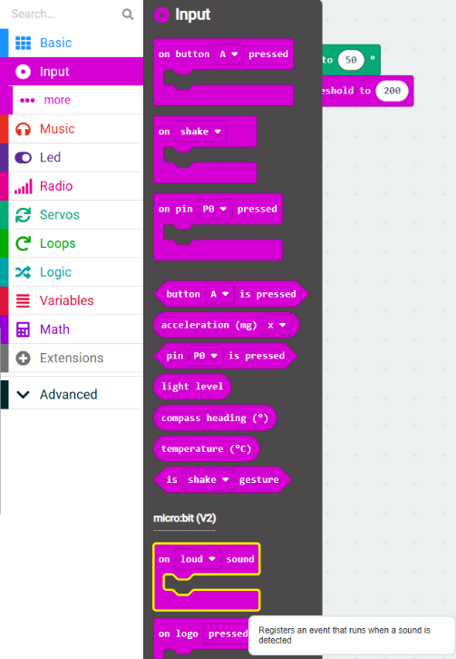
3. Write the “loud sound detected” block of code
Next we will write a new block of code which is what happens when your Bot detects a loud sound.
Click on “Input” on the menu.
Then select the block of code “on loud sound” that is under the micro:bit (V2) title.
1.
2.

Slide 22
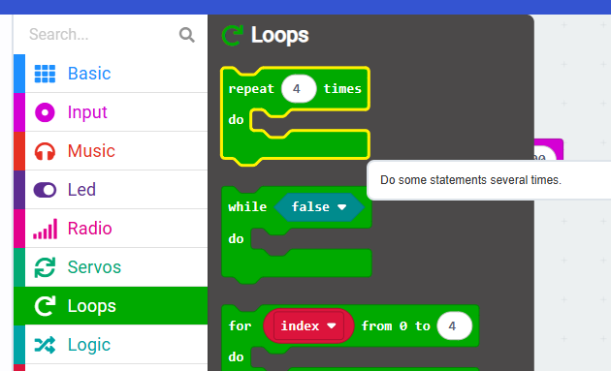
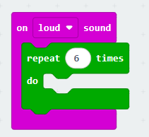
3. Write the “loud sound detected” block of code
Next we will write a loop. This is a block that will repeat the code inside as many times as we tell it to.
Click on “Loops” on the menu.
Then select the block of code “repeat 4 times” and drag this into the “on loud sound” block.
Change the number of repeats to 6.
2.
1.
3.

Slide 23
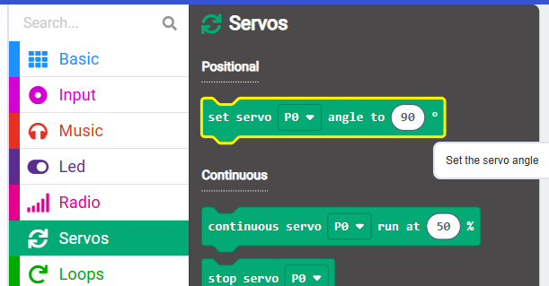
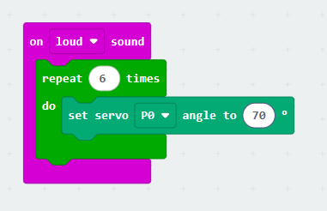
3. Write the “loud sound detected” block of code
Inside the repeat block we will set the servo angle and pause for two different angles.
Click on “Servos” on the menu.
Select the “set the servo angle” block of code and drag it into the repeat block.
Change the angle to 70º.
2.
1.
3.

Slide 24
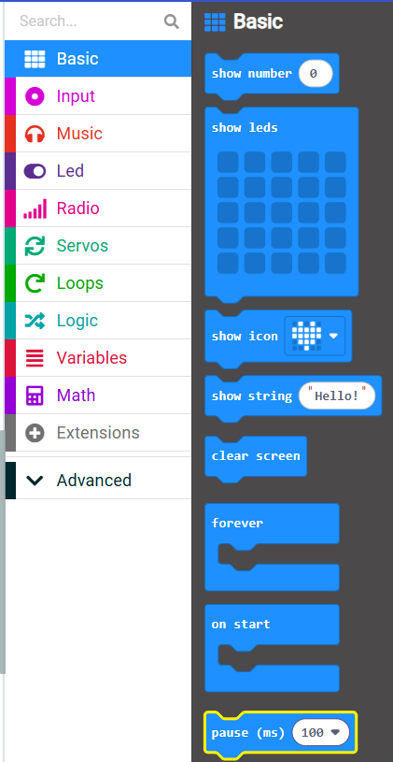
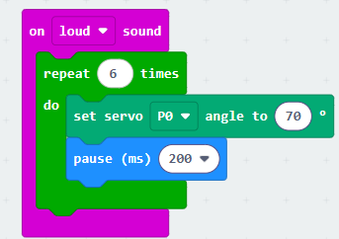
3. Write the “loud sound detected” block of code
Click on “Basic” on the menu.
Select the “pause” block of code and drag it into the repeat block under the set servo block.
Change the time to 200 ms.
1.
3.
2.

Slide 25
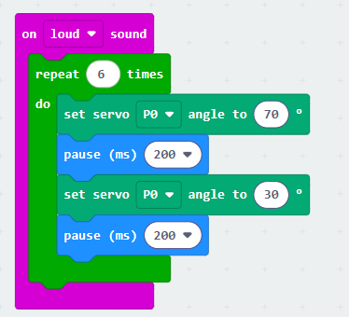
3. Write the “loud sound detected” block of code
Repeat the last two slides of instructions so that you have a second set servo angle, with the angle set to 30º and a second pause.

Slide 26
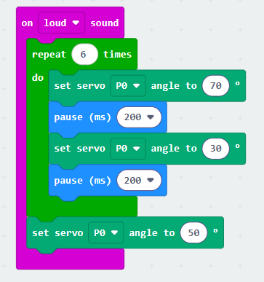
3. Write the “loud sound detected” block of code
Finally add one more set servo angle block of code to the bottom of the on loud sound block of code after the repeat loop. Set this angle to 50º.

Slide 27
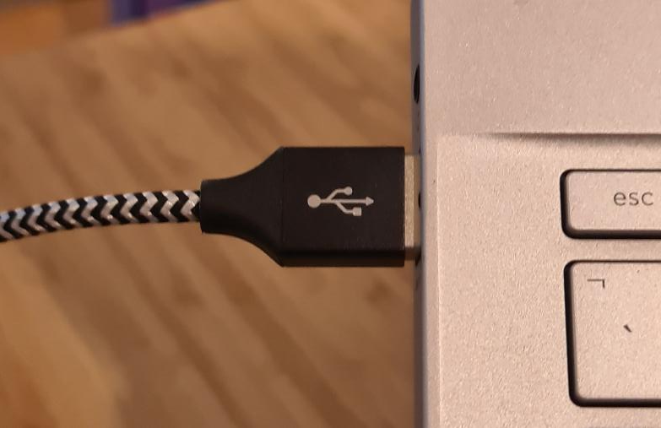
Running the code
Now it is time to download and run the code onto the micro:bit.
Connect the micro:bit’s micro USB cable into the computer you are writing your code on.

Slide 28

Running the code
Click on the Download button.
Follow the on-screen instructions to pair your micro:bit with the computer.
This should end with the code being downloaded onto your micro:bit.
Any problems with connecting the micro:bit please refer to the micro:bit help:
https://microbit.org/get-started/user-guide/transfer-code-to-the-microbit/

Slide 29

Testing the Code
Finally you get to test your code.
Make a loud noise next to the micro:bit and the servo should move.
The best way to make a loud noise is to clap.

Slide 30
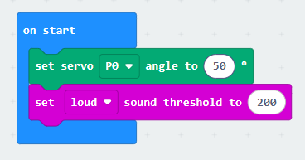
Adjusting the Code
You now need to decide if your code does what you want.
Loud level
  Does the micro:bit react to the right level of noise? If not you can change the loud threshold number.
  Remember to download the code again every time you make a change.
1.

Slide 31
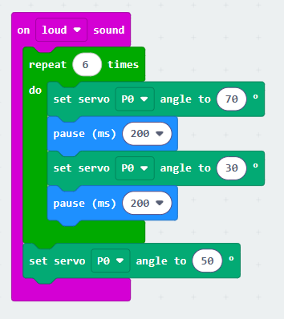
Adjusting the Code
You can have your robot wave slower by increasing the pause time.
Does the servo move enough? Remember you will be sticking larger arms onto the servo. But do you want the angle of movement to be greater? If so, change the angles for the servo. Remember to leave the final set servo at 50 though!
Remember to download the code again every time you make a change.
3.
2.

Slide 32

Code is complete!
Your code is ready for your Bot.
Next session you will be making your Bot.
Notes:
Disconnecting the Microbit from the computer – you can just remove the cable from the computer without ejecting.

Slide 33
Which skills did we use today?
Solving problems in sensible ways
Logical
Putting in lots of effort
Observant
Learning about new things
Curious

