Slide 1
Primary Electronics: Build a Bot
Session 2 – Code V2

Slide 2
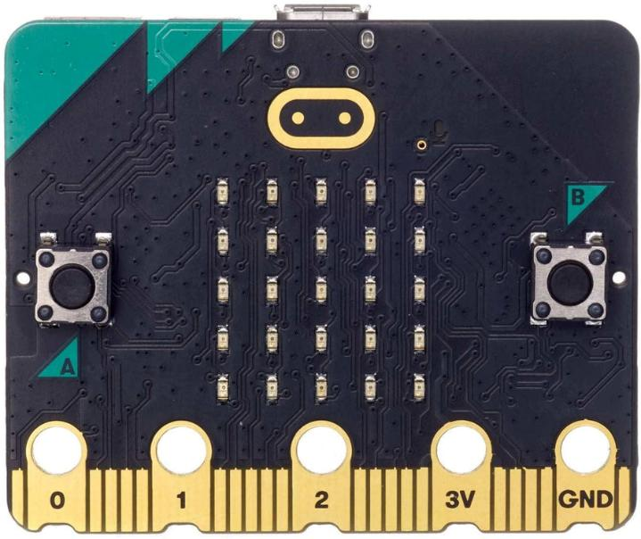
Coding Session
In this session you will be writing the code for your Bot on a Micro:bit

Slide 3
Which skills will we use today?
Solving problems in sensible ways
Logical
Putting in lots of effort
Observant
Learning about new things
Curious

Slide 4
Micro:bits
In this session you will be connecting your micro:bit to the servo and writing the code.
What is a micro:bit?
The micro:bit is a little computer that you can code to react to the world around it using its amazing sensors.

Slide 5
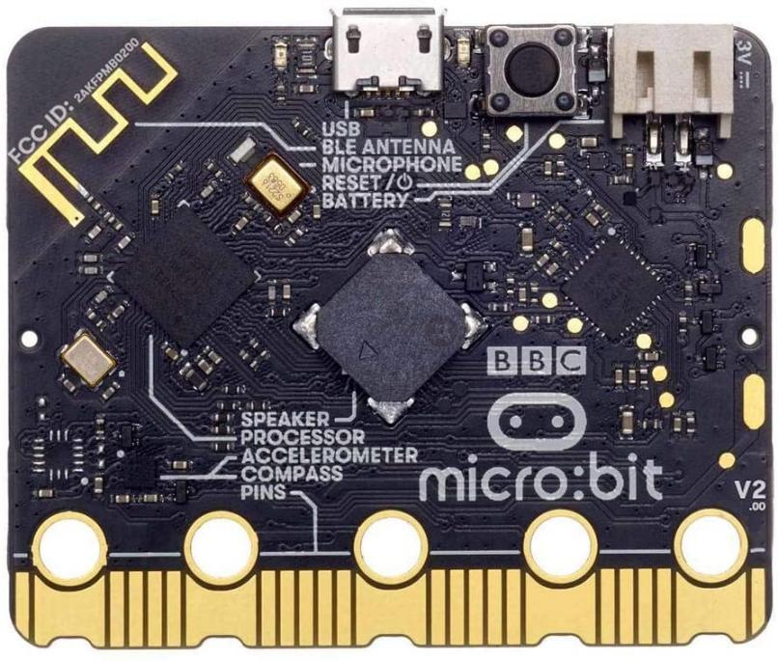
Micro:bits
The micro:bit has sensors but they are small and can be hard to see!
For the Bot we are going to use the microphone to sense any loud noises.
Can you see it on the micro:bit?

Slide 6
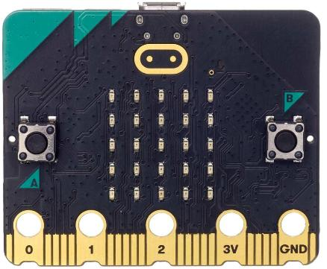
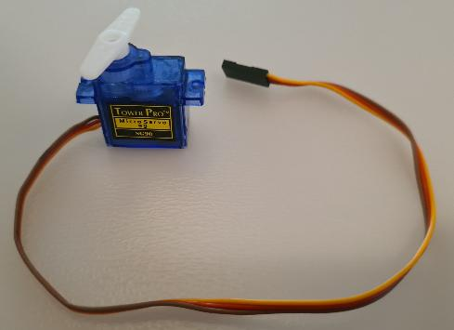
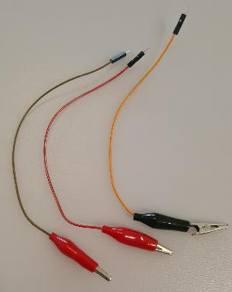
Connecting the parts
Parts you need today:
Micro:bit | Servo | x3 Crocodile to jumper pin cables

Slide 7
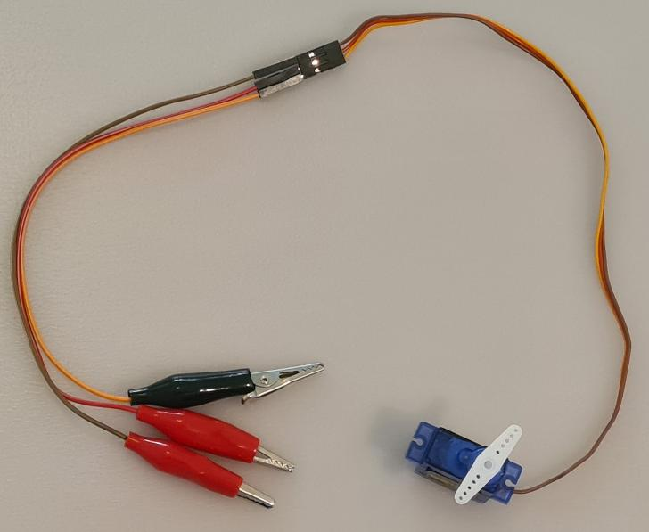
Connecting the parts
Connect the 3 crocodile to jumper pin cables to the servo header

Slide 8
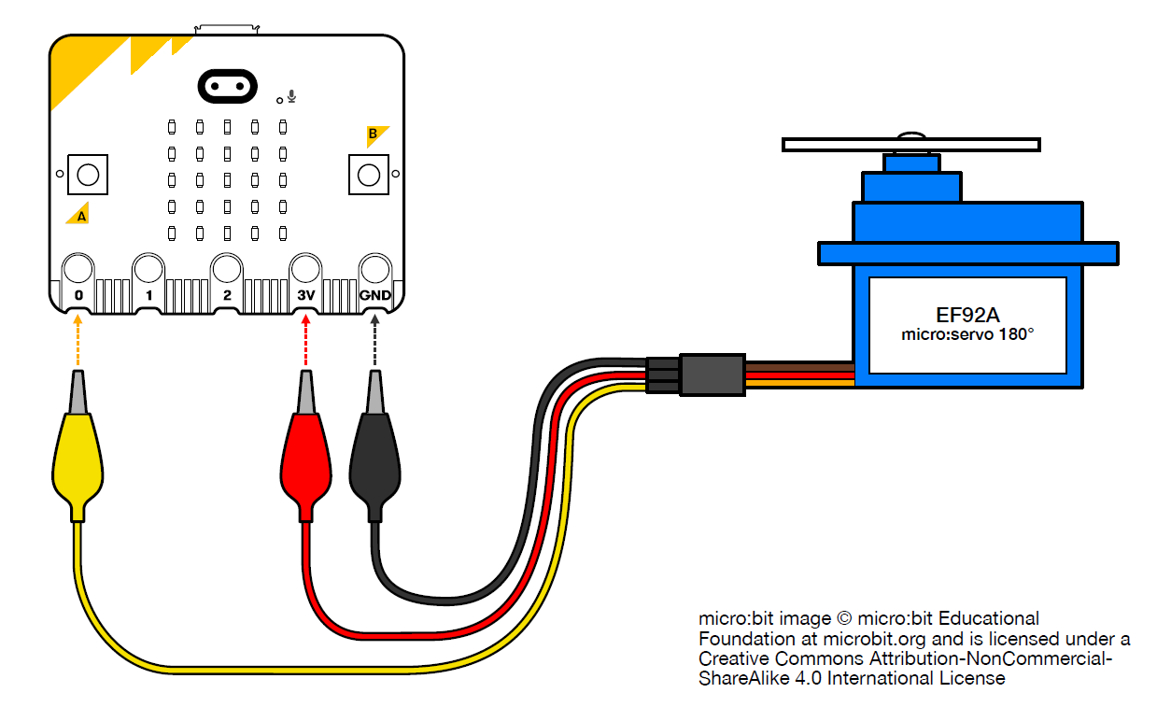
Connecting the parts
Connect the crocodile clips to the micro:bit as follows:
Crocodile clip connected to the YELLOW servo wire → micro:bit pin 0
Crocodile clip connected to the RED servo wire → micro:bit pin 3V
Crocodile clip connected to the BROWN servo wire → micro:bit pin GND
NOTE: the colours of the wires attached to the crocodile clip may NOT match.
It is important to just ensure the right servo colour wire goes to the right pin.

Slide 9
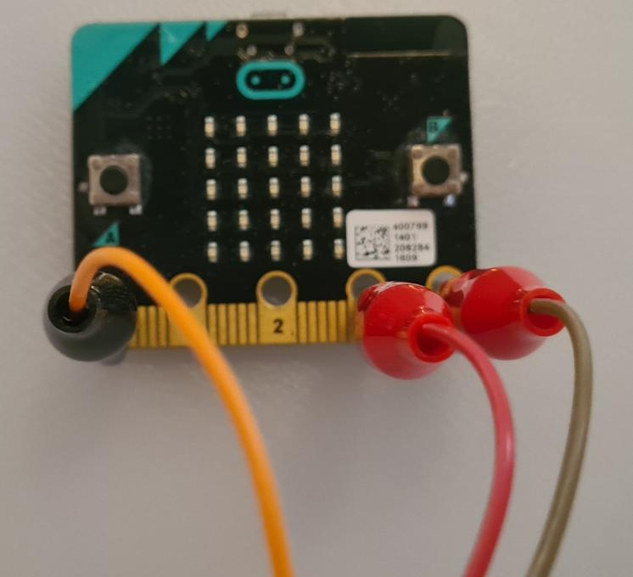
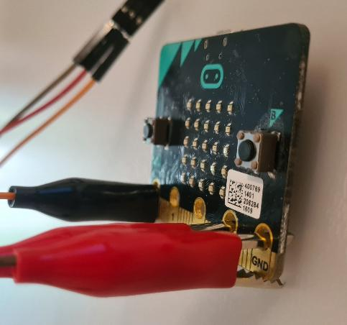
Connecting the parts
Note that the clips are attached perpendicularly to the micro:bit for a more secure grip.

Slide 10
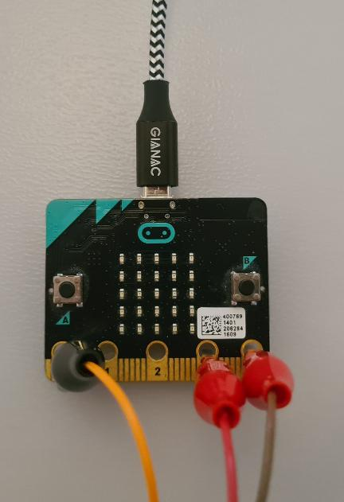
Connecting the parts
Finally connect the micro USB cable to the micro:bit.
NOTE:
Be gentle with cable. It only goes in one way up!
It will stick out a little bit like in the photo

Slide 11
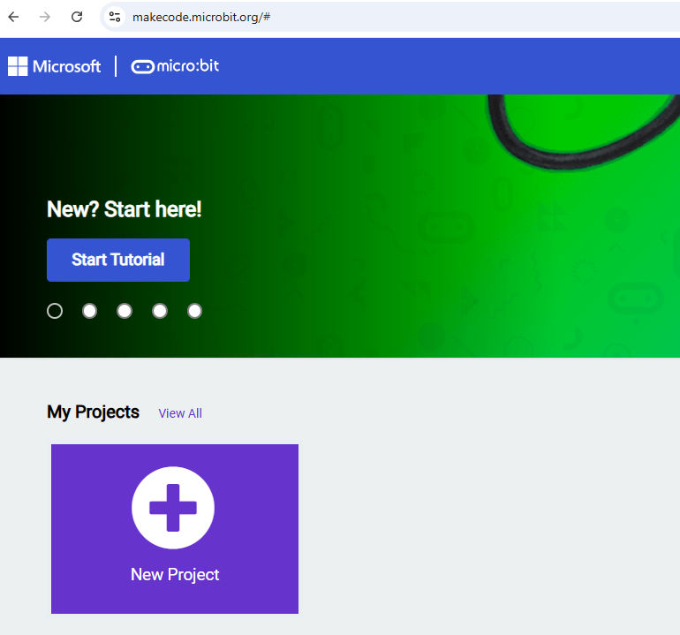
Write the code
You will be writing the code on the micro:bit website.
Go to: https://makecode.microbit.org
Then click on “New Project”.
1.
2.

Slide 12
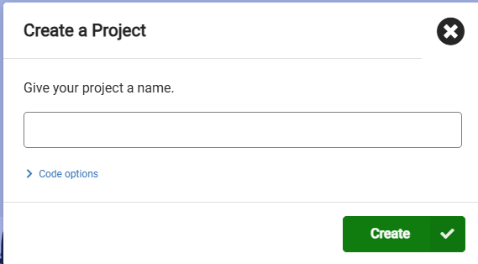
Write the code
A window will pop up asking you to name the project.
Type in your Bot’s name!
Then click on “Create”.
1.
2.

Slide 13
Writing the code
You will need to write code that will change the angle of the servo when the micro:bit senses a loud noise. Changing the angle will mean the arms attached to it will move up and down like a wave.
We will do this in a few steps:
1. Set up micro:bit code editor so we can write code for a servo
2. Write the “start” block of code to:
Set the servo to a particular angle when it turns on (50º)
Set the level of “loudness” that we want the Bot to react to by waving
3. Write the “loud sound detected” block of code to:
Set the servo to 70º and pause
Set the servo to 30º and pause
Repeat 6 times
Set the servo back to 50º

Slide 14
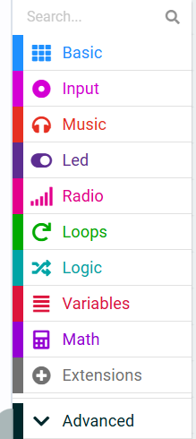
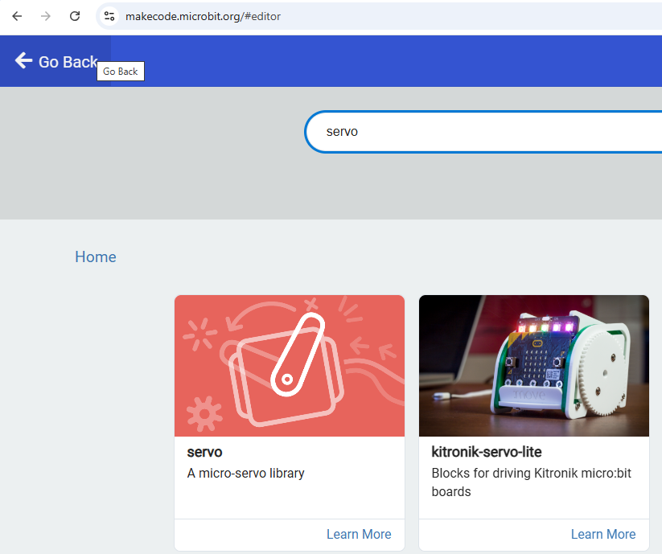
1. Step up the micro:bit editor
You will need to add an extension to use the servo with the micro:bit.
Click on “Extensions” in the menu
Type in “servo” in the search bar then press Enter.
Click on the servo icon that will appear
2.
3.
1.

Slide 15
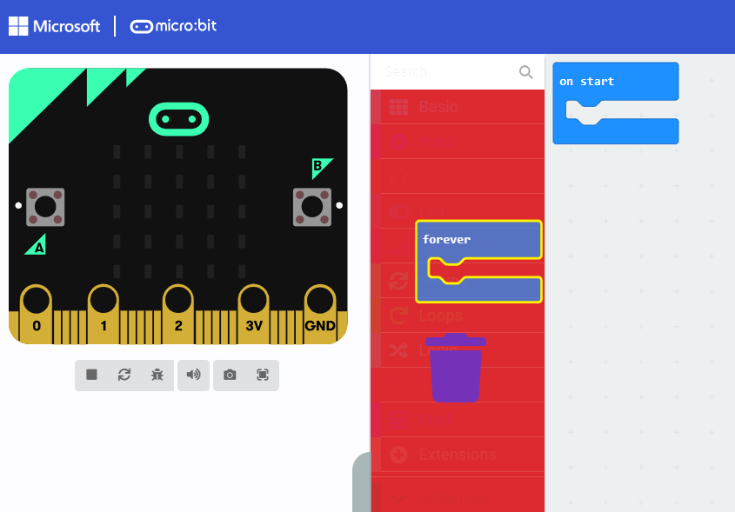
1. Step up the micro:bit editor
Remove the “forever” block by dragging it over the menu and letting go when you see a “bin” icon.

Slide 16
2. Write the “start” block of code
Now we have set up everything we need, here is a reminder of what this second step needs to do:
Set the servo to an angle of 50º when it turns on
Set the level of “loudness” that we want the Bot to react to by waving.

Slide 17
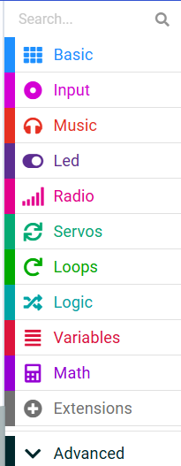
2. Write the “start” block of code
Set the servo to an angle of 50º when it turns on
Can you look through the Servos section to find the block that will set the servo angle?
1.

Slide 18
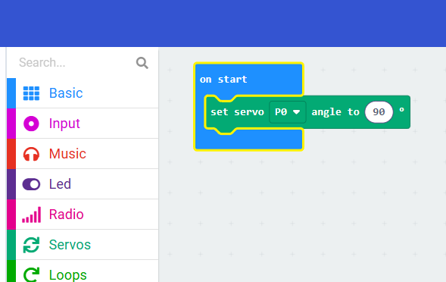
2. Write the “start” block of code
1.
Set the servo to an angle of 50º when it turns on
Great, now you have found it, put it in the “on start” block.
Then change the number on the left (which currently says 90) to 50
2.

Slide 19
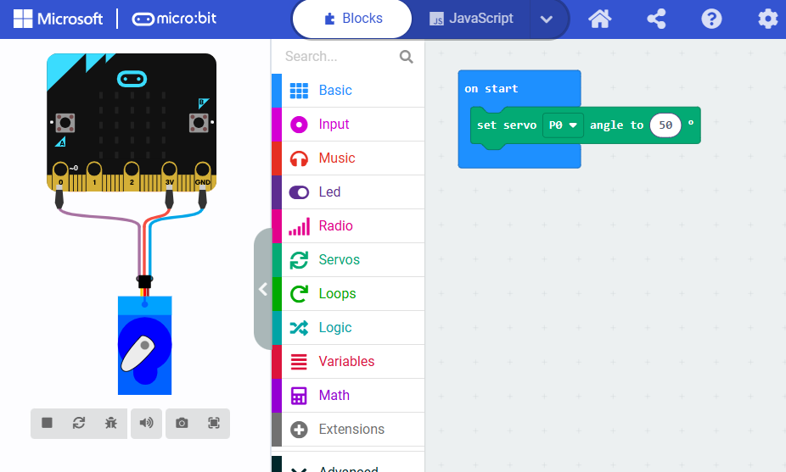
2. Write the “start” block of code
You will see that in the diagram on the left, a servo appears attached to the micro:bit just like the one we have connected.
Remember this line of code. You may find later that you want to change the value of 50 if the angle is not right when your Bot is waving.

Slide 20
2. Write the “start” block of code
1.
Set the level of “loudness” that we want the Bot to react to by waving
To complete this next step, we will set the sound threshold to 200.
Look through the Input blocks this time to find the write block.
HINT: there are “… more” inputs!

Slide 21
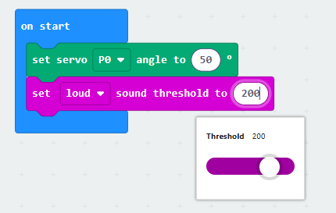
2. Write the “start” block of code
Set the level of “loudness” that we want the Bot to react to by waving
Great, now you have found it, put it in the “on start” block, under the previous green block..
Then change the threshold to 200
The start block is now written.
1.
2.

Slide 22
3. Write the “loud sound detected” block of code
A reminder of what the last step needs to do.
When the loud sound is detected:
Repeat the following 6 times
Set the servo to 70º and pause for 200 ms
Set the servo to 30º and pause for 200 ms
Set the servo back to 50º

Slide 23
3. Write the “loud sound detected” block of code
1.
When the loud sound is detected:
This is an input. Look through the “Input” blocks to find a block that runs when there is a loud sound.

Slide 24
3. Write the “loud sound detected” block of code
Repeat the following 6 times
When code is repeated it is called a loop. Look through the “Loops” blocks to find the repat block.
Drag this block into the “on loud sound” block and set the number of repeats to 6.
1.

Slide 25
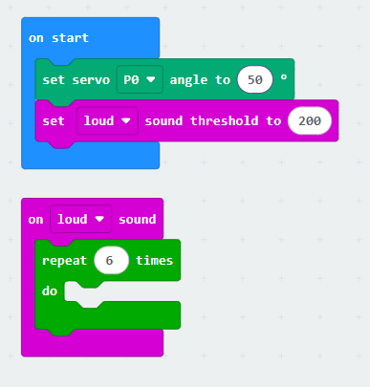
3. Write the “loud sound detected” block of code
Code check:
This is the code you should have so far

Slide 26
3. Write the “loud sound detected” block of code
2.
Set the servo to 70º and pause for 200 ms
Set the servo to 30º and pause for 200 ms
You have used the “set servo” block before, so find that and add it to the on loud sound block. Remember to change the angle.
Now find the pause block in the “Basics” menu and add this after the set servo block. Change the number to 200.
You need two sets of these blocks – one to set the servo to 70º, one to set the servo to 30º.
1.

Slide 27
3. Write the “loud sound detected” block of code
Set the servo back to 50º
Finally add one more “set servo” block of code to the bottom of the on loud sound block of code after the repeat loop. Set this angle to 50º.
1.

Slide 28
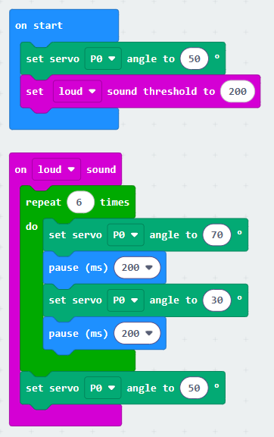
3. Write the “loud sound detected” block of code
Final code check:
This is the code you should have for your bot.

Slide 29
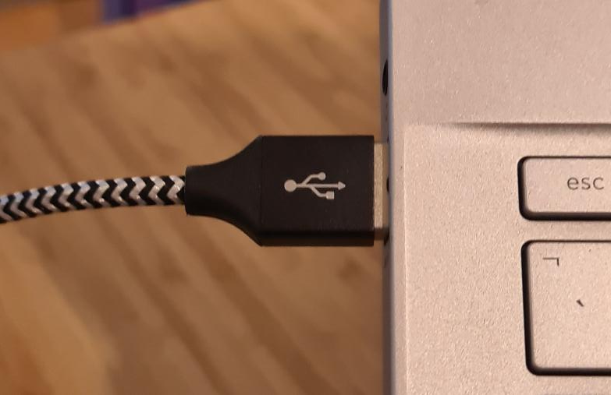
Running the code
Now it is time to download and run the code onto the micro:bit.
Connect the micro:bit’s micro USB cable into the computer you are writing your code on.

Slide 30

Running the code
Click on the Download button.
Follow the on-screen instructions to pair your micro:bit with the computer.
This should end with the code being downloaded onto your micro:bit.
Any problems with connecting the micro:bit please refer to the micro:bit help: https://microbit.org/get-started/user-guide/transfer-code-to-the-microbit/

Slide 31
Testing the Code
Finally you get to test your code.
Make a loud noise next to the micro:bit and the servo should move.
The best way to make a loud noise is to clap.

Slide 32
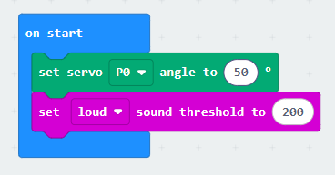
Adjusting the Code
You now need to decide if your code does what you want.
Loud level
Does the micro:bit react to the right level of noise? If not you can change the loud threshold number.
Remember to download the code again every time you make a change.
1.

Slide 33
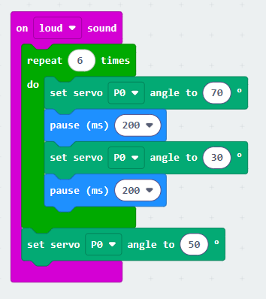
Adjusting the Code
You can have your robot wave slower by increasing the pause time.
Does the servo move enough? Remember you will be sticking larger arms onto the servo. But do you want the angle of movement to be greater? If so, change the angles for the servo. Remember to leave the final set servo at 50 though!
Remember to download the code again every time you make a change.
3.
2.

Slide 34
Code is complete!
Your code is ready for your Bot.
Next session you will be making your Bot.
Notes:
Disconnecting the Microbit from the computer – you can just remove the cable from the computer without ejecting.

Slide 35
Which skills did we use today?
Solving problems in sensible ways
Logical
Putting in lots of effort
Observant
Learning about new things
Curious

