Slide 1
Primary Electronics: Build a Bot

Slide 2

Design and Build a Bot!
We are going to build on your electronics skills by designing and building a Bot!
The Bot will guard your classroom and wave whenever someone makes a noise.
The Bot will be made using a Microbit, a servo, paper and your creativity!

Slide 3
Skills that help Electronics Engineers succeed
In each session we will use some of the skills that help Electronics Engineers succeed

Slide 4
Primary Electronics: Build a Bot
Session 1 - Design

Slide 5
Design
This session you will design what your Bot will look like.
The Bot will have a rectangular body to hold the components needed to make it move. But all its other parts can be designed by you.
The Bot will need “arms” that can wave.
Notes:
Can add in writing for a purpose as part of the worksheet – label with post it notes, etc

Slide 6
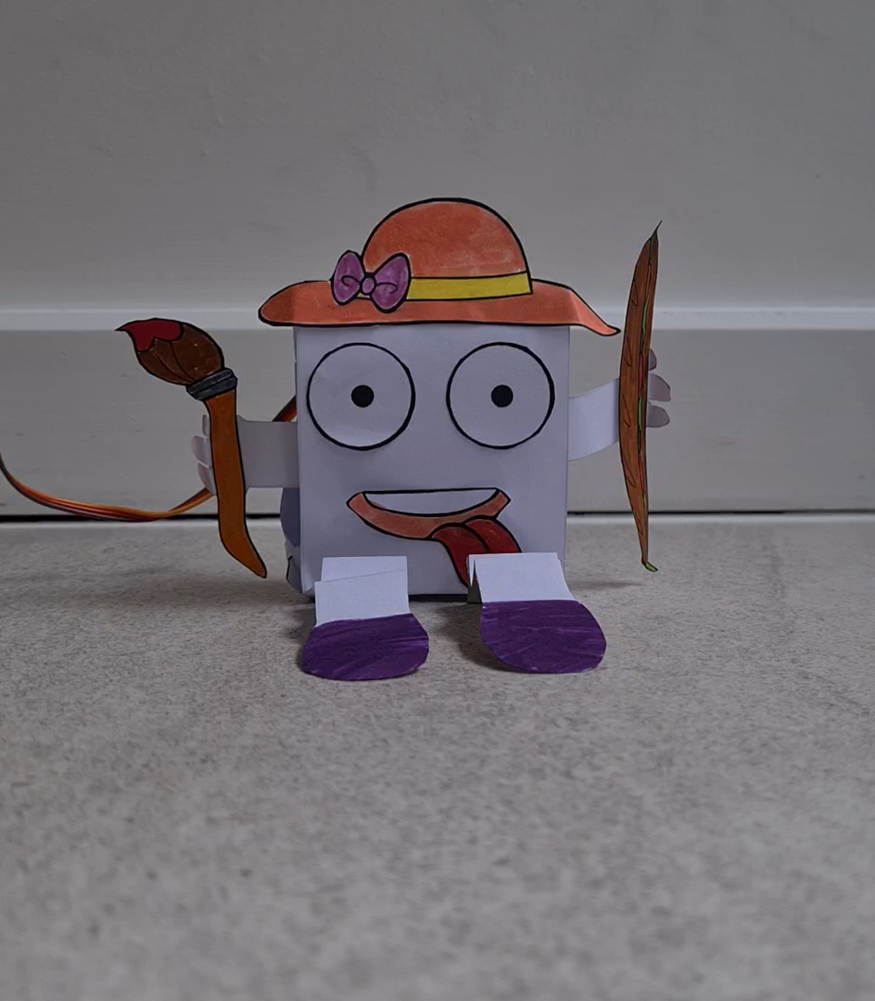
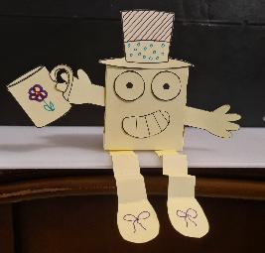
Examples of Bots
Here are some example Bots, including a video of one dancing!

Slide 7


Which skills will we use today?
Listening and respecting others’ views
Open-minded
Making new things
Creative
Thinking of new ideas
Imaginative
With thanks for support with the STEM Attributes from

Slide 8
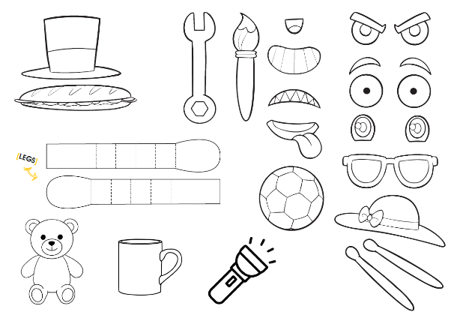
Design
What you need to design for your Bot:
A name
Arms
Face
Body decoration
Legs
Optional:
  Accessories such as hats, hair, things to hold etc.

Slide 9
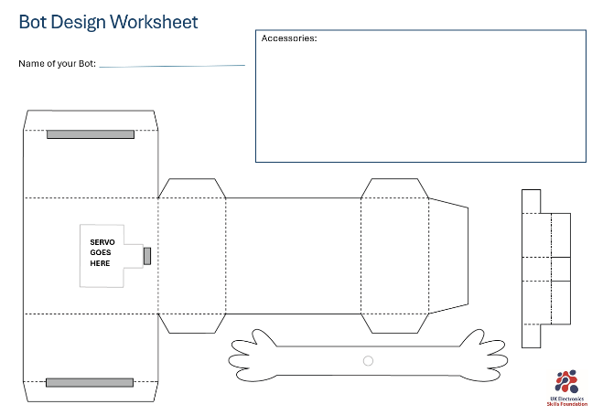
Using the worksheets
A box to draw in any accessories you want for your Bot
This the main body of the Bot.
This is where to plan the face.
This is the servo holder which will be hidden
Arms

Slide 10
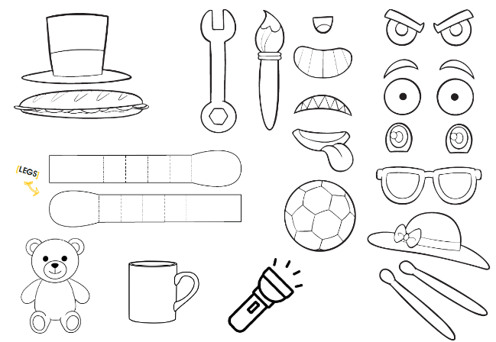
Using the worksheets
Use some of these accessories or draw your own
Legs

