Slide 1
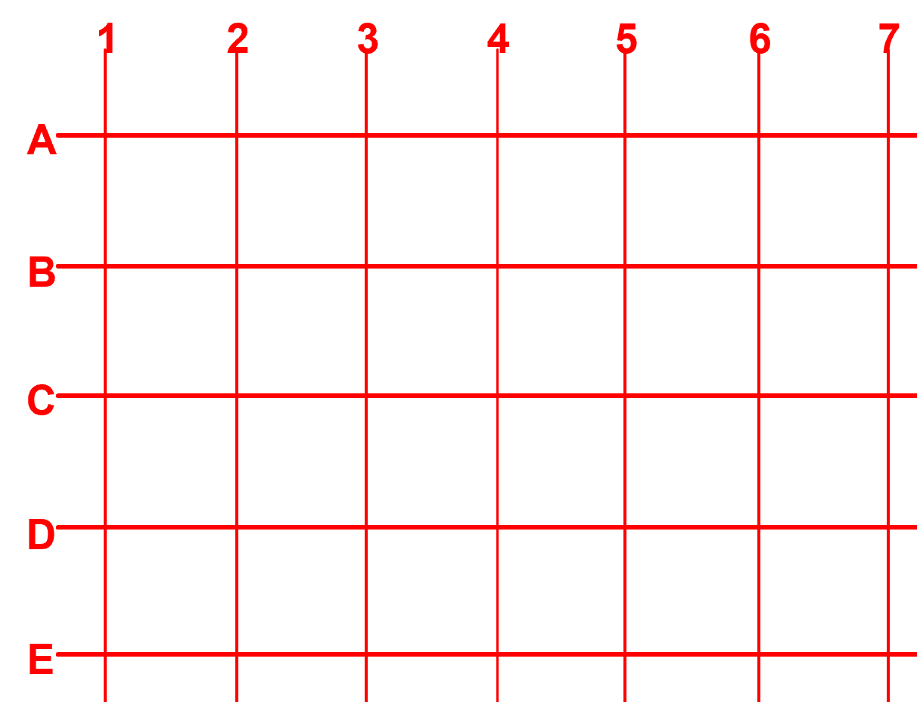
Experiment 1 –
Circuit Loops and Resistance
Battery
Wire
3V
B1
3
R1
100
Ω
RESISTOR
3V
Resistor
LED
3
B1
R1
D1
100
Ω
RESISTOR
LED
Only works 1 way
D1
LED

Slide 2
Experiment 2 – LED and Lamp
Battery
LED
D1
3V
LED
Only works 1 way
B1
Wires
2
Switch
3
6
2
3V
S1
SLIDE SWITCH
D1
Or
6
LAMP
LED
B1
S2
PRESS SWITCH
3
S1
Lamp
SLIDE SWITCH
LAMP

Slide 3
Experiment 3 – Tilt Switch
Battery
Wires
3V
B1
3
3
6
D1
2
LED
LED
LAMP
D1
6
3V
LED
C
B1
Tilt switch
S7
1
TILT SWITCH
2
C
3
S7
1
TILT SWITCH
2

Slide 4
Experiment 4 – Light Sensor
Battery
Transistor
3V
6
B1
NPN
Q2
R1
D1
LED
100
Ω
S1
Wires
RESISTOR
LED
SLIDE SWITCH
D1
LED
3
Resistor
2
3V
R1
3
RP
NPN
100
Ω
RESISTOR
B1
Switch
PHOTO
RESISTOR
Q2
6
S1
SLIDE SWITCH
2
Light Sensor
RP
PHOTO
RESISTOR

